Slide 1
What Is a Problem?

Slide 2
Didactic Suggestions (1)
These are only suggestions, any group of learners is free to experiment with the use of the micro-module. The types, number and order of use of the elements in the micro-module are open to choice. Depending on the learning strategy adopted, elements can be also eliminated or added. For this purpose, the micro-modules can be copied and modified.
(I) Try to start by connecting with the current state of knowledge and experience of the individual in the group/s.
Organize students into group/s of 4 or 5
(2) Ask the participants in the group/s to recall:
(a) a problem they manage to solve individually or along with others, and
(b) a problem they could not solve individually or along with others.
Focus on the problem (not the solution).
Ask them to reflect about: What is a Problem?
Ask the the groups to convene and share their results by selecting and presenting 2 “solved problems” and 2 “unsolved problems” per group. Then, they present their conclusions regarding “What is a Problem?”

Slide 3
Didactic Suggestions (2)
(II) Use the micro-module “What is a Problem?” to reinforce and deepen the understanding of the concept of “Problem.”
Introduce the micro-module “What is a Problem?” to the participants, explaining its multimedia, multi-dimensional, multi-role, multi-didactic intention.
Ask the participants in the group/s to explore the micro-module searching, focusing their attention and reflecting on those elements they find most effective in reinforcing and deepening their understanding of the concept of “Problem.”
The participants tell their groups about their first three choices of “most effective elements” and explain why they have selected them. The participants reflect collectively about their choices and their reasons. If some participants do not find the types of elements most appropriate to them, they can tell about those element and, even better, find them and contribute them to the micro-module.
The groups convene and share their results by selecting and presenting 3 choices of “most effective elements” per group, along with their conclusions as to why different people may have different preferences regarding elements and ways of learning.
Participants fill in the brief questionnaire about their preferences regarding the elements in the micro-module.

Slide 4
What Is a Problem?
A PROBLEM is a difference or gap between an existing situation and a desired situation (i.e., the goal or objective). The difference or gap is the unknown entity of the problem and it may take many forms, from a simple arithmetic problem to complex social problems.
A PROBLEM includes opportunities to do new and better things, for instance, as a result of technological change
A PROBLEM only exists if people (e.g., an individual, social groups, or societies) perceives it as such, that is, they believe that it is worth finding the unknown and close the gap between the existing and the desired situations.

Slide 5
What Isa Problem? - Wisdom
Every problemisagift-withoutproblemswewouldnot grow.
Anthony Robbins
You may not always have a comfortable life and you will not always be able to solve all of the world’s problems at once but don’t ever underestimate the importance you can have because history has shown us that courage can be contagious and hope can take on a life of its own
Michelle Obama
We can not solve our problems with the same thinking we used when we created them.
Albert Einstein
It’s not that I’mso smart, it’s just that I stay with problems longer.
Albert Einstein
A problem is a chance for you to do your best
Duke Ellington
If a problem can be solved there is no use worrying about it.
If it can't be solved, worrying will do no good.
Tibetan saying

Slide 6
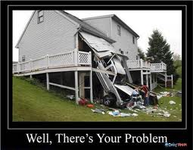
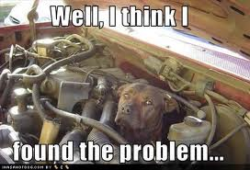
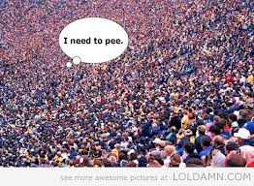
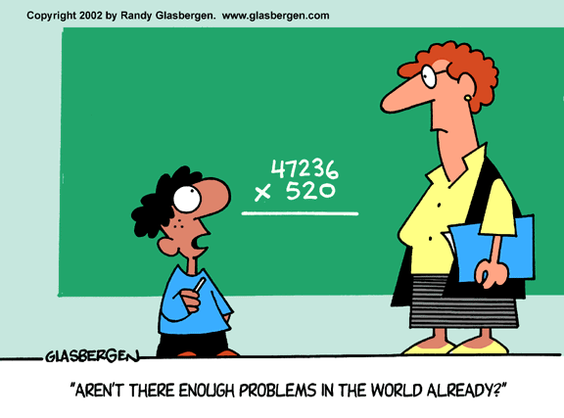
What is a Problem? Fun

Slide 7
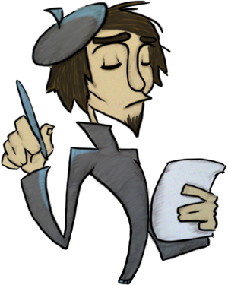
What Is a Problem? - Poetry
Problems are stepping-stones to learning
Measured stress to make you ponder and think
Puzzles of life to study and solve
Keeping you looking for the missing link.
(Part of a Poem by Jeanette Cooper)

Slide 8
Brief Questionnaire
How do you rate the usefulness of the following elements for your learning?
 | Very Low | Low | Moderate | High | Very High
Definition
Wisdom
Fun
Poetry
What other elements would you like to see in the micro-module?

Slide 9
Acknowledgements
Developed by
Alfonso Molina
Sources
Various works by David Jonassen
Various Quotation Websites
Various Poetry Websites
Various websites with images relating to the concept of Problem

