Slide 1

What Is a Solution?

Slide 2
Didactic Suggestions (1)
These are only suggestions, any group of learners is free to experiment with the use of the micro-module. The types, number and order of use of the elements in the micro-module are open to choice. Depending on the learning strategy adopted, elements can be also eliminated or added. For this purpose, the micro-modules can be copied and modified.
(I) Try to start by connecting with the current state of knowledge and experience of the individual in the group/s.
Organize students into group/s of 4 or 5
(2) Ask the participants in the group/s to recall:
  (a) a completely satisfactory solution they individually or along with others found to a problem, and
  (b) a solution that would have been a better alternative to a “solution” that was implemented but turned out not to be fully satisfactory.
  Focus on the solution (not the problem)
Ask them to reflect about: What is a Solution?
Ask the groups to convene and share their results by presenting the “completely satisfactory solution” and the “better alternative solution” per group. Then, they present their conclusions regarding “What is a Solution?”

Slide 3
Didactic Suggestions (2)
(II) Use the micro-module “What is a Solution?” to reinforce and deepen the understanding of the concept of “Solution.”
Introduce the micro-module “What is a Solution?” to the participants, explaining its multimedia, multi-dimensional, multi-role, multi-didactic intention.
Ask the participants in the group/s to explore the micro-module searching, focusing their attention and reflecting on those elements they find most effective in reinforcing and deepening their understanding of the concept of “Solution.”
The participants tell their groups about their first three choices and explain why they have selected them. The participants reflect collectively about their choices and their reasons. If some participants do not find the types of elements most appropriate to them, they can tell about those element and, even better, find them and contribute them to the micro-module.
The groups convene and share their results by selecting and presenting 3 choices per group, along with their conclusions as to why different people may have different preferences regarding elements and ways of learning.
Participants fill in the brief questionnaire about their preferences regarding the elements in the micro-module.

Slide 4
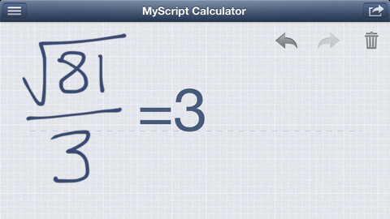
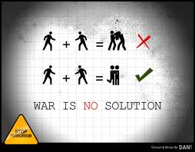

What Is a Solution?
A SOLUTION is the means and process(es) leading to the closing of the gap between the existing and the desired situations.
Many problems have several solutions.

Slide 5

What Isa Solution? - Wisdom
A problem well stated is a problem half-solved.
Charles Kettering.
The important thing about a problem is not its solution, but the strength we gain in finding the solution
Seneca
For every complex problem, there is a solution that is simple, neat, and wrong.
H. L. Mencken
Believe it can be done. When you believe something can be done, really believe, you rmind will find the ways to do it. Believing a solution paved the way to solution.
David Joseph Schwartz
All progress is precarious, and the solution of one problem brings us to face with another problem.
Martin Luther King

Slide 6
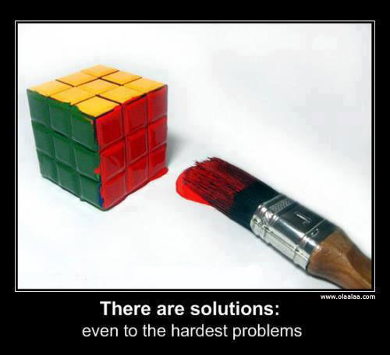
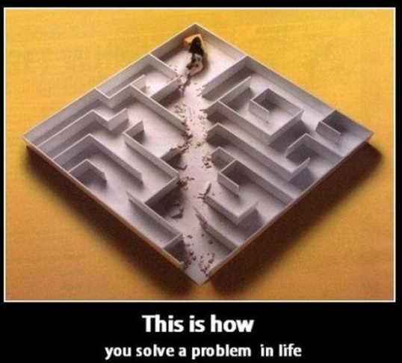


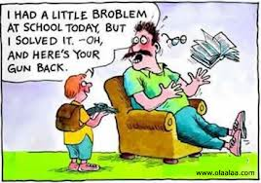
What is a Solution? - Fun

Slide 7

What Is a Solution? - Poetry
The gift of the solution, the one we seek to win, starts with our own thinking, the answer deep within.
Part of a Poem by Michael Charles Messineo

Slide 8
Brief Questionnaire
How do you rate the usefulness of the following elements for your learning?
 | Very Low | Low | Moderate | High | Very High
Definition
Wisdom
Fun
Poetry
What other elements would you like to see in the micro-module?

Slide 9
Acknowledgements
Developed by
Alfonso Molina
Sources
Various works byDavid Jonassen
Various Quotation Websites
Various Poetry Websites
Various websites with images relating to the concept of Problem

