Slide 1

Learning Approaches Relevant to Education for Life
Constructivist-Constructionist
Active
Experiential-Authentic
Project-based
Enquiry-based
Brain-based
Self-organised-Autonomous

Slide 2
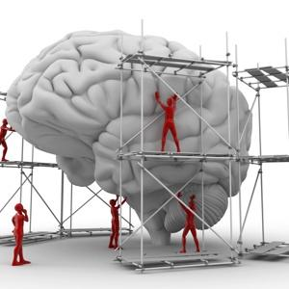
Learning Approaches Relevant to Education for Life
Active
Experiential
Authentic
Constructivist
Constructionist
Self-organised
Autonomous
Brain-based
Project-based
Enquiry-based

Slide 3
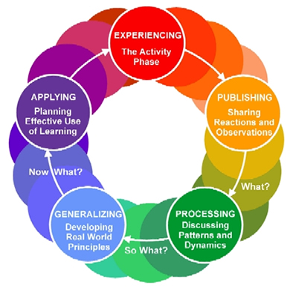
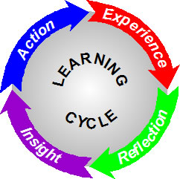
Experiential Learning Approach
Experiential Learning
Experiential Learning

Slide 4
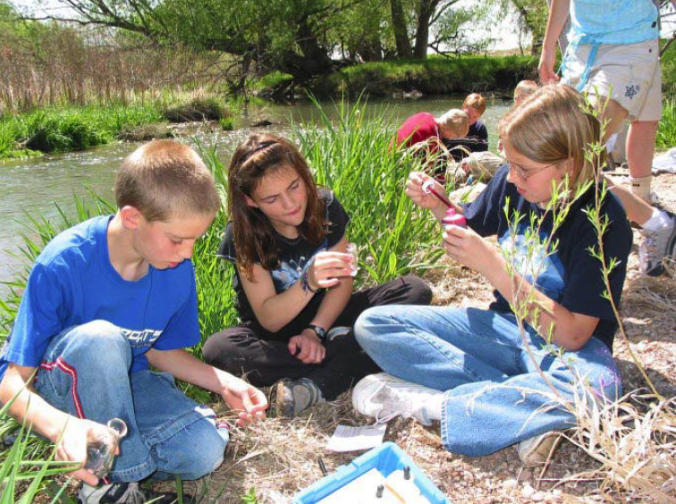
Authentic Learning
Real World Relevance
Ill-defined Problem
Multiple Interpretations & Outcomes
Sustained Investigation
Polished (Final) Products
Multiple Sources and Perspectives
Integrated Assessment
Collaboration
Interdisciplinary Perspective
Reflection (Metacognition)
(Lombardi, 2007, http://net.educause.edu/ir/library/pdf/eli3009.pdf)

Slide 5
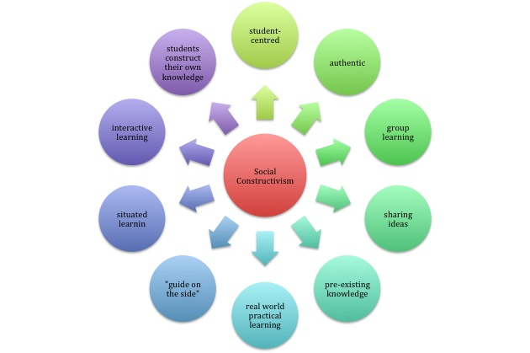
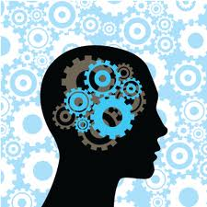
Constructivist Learning Approach

Slide 6
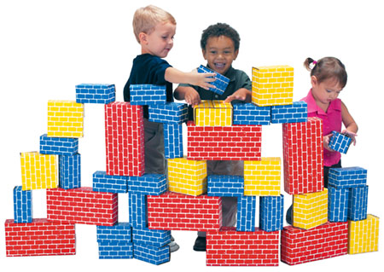
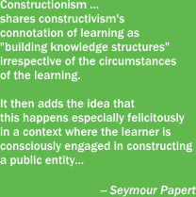
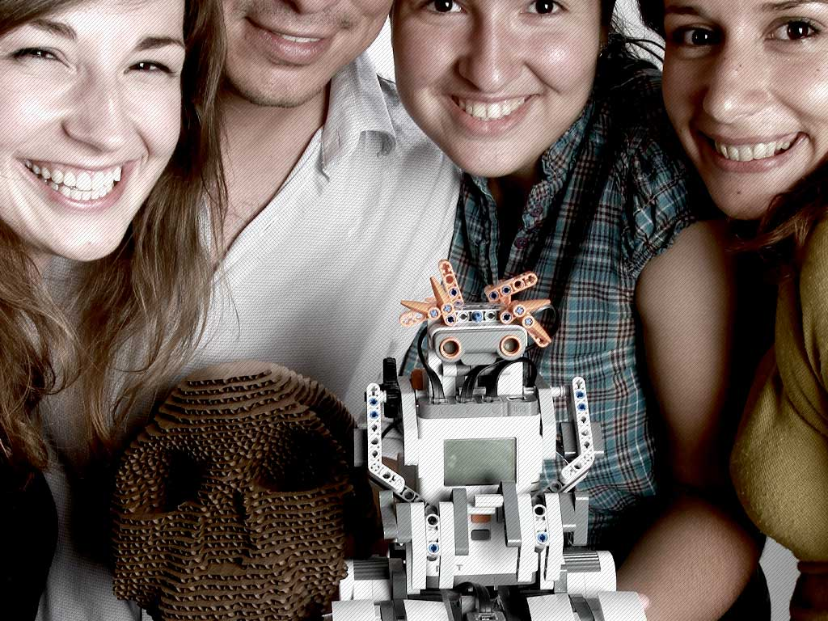
Constructionist Learning Approach

Slide 7
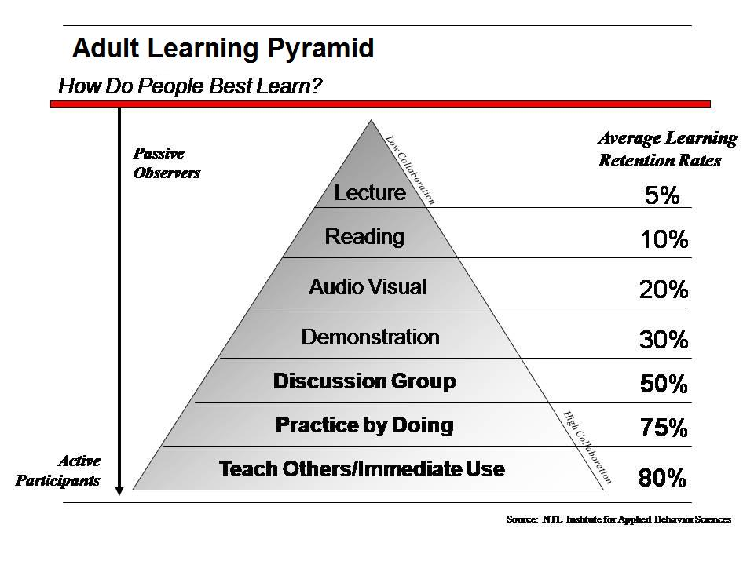
Active Learning Approach

Slide 8
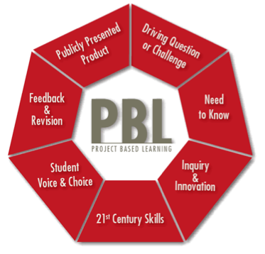

Project-based Learning Approach (PBL)

Slide 9
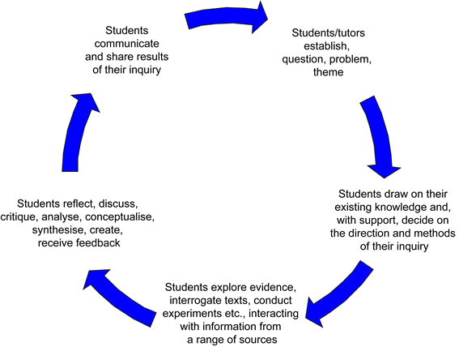

Enquiry-based Learning Approach

Slide 10
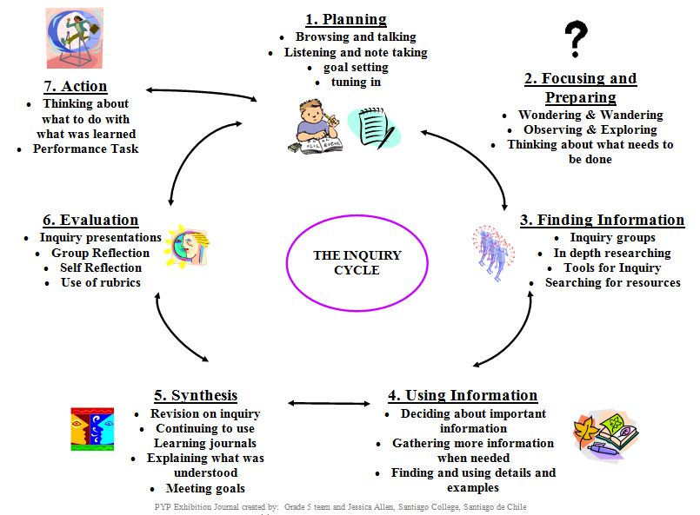
Enquiry-based Learning Approach

Slide 11
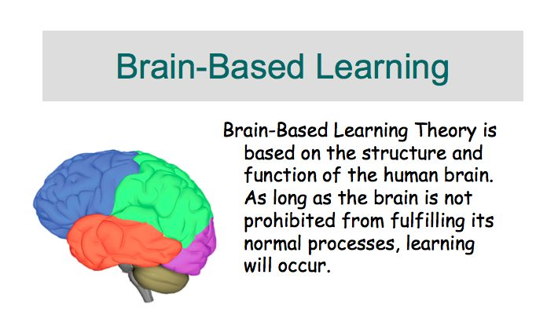
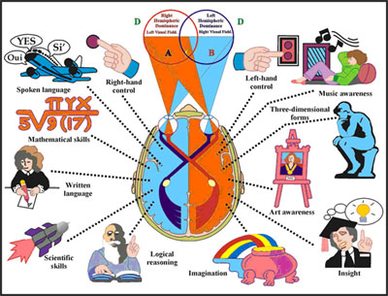
Brain-based Learning Approach

Slide 12

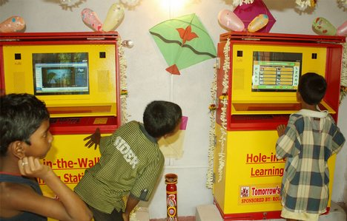
Self-organised Learning Approach
Self-organized learning covers ways of learning, which allow learners- in comparison to traditional educational scenarios- a major dimension of self- determination and self-regulation: self-regulated learning is a self-initiated action that involves goal setting and regulating one’s efforts to reach the goal. (Kalz and Koper)
The Hole in the Wall

Slide 13
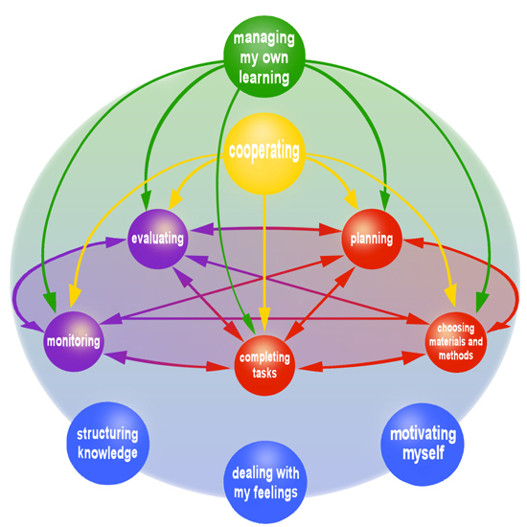
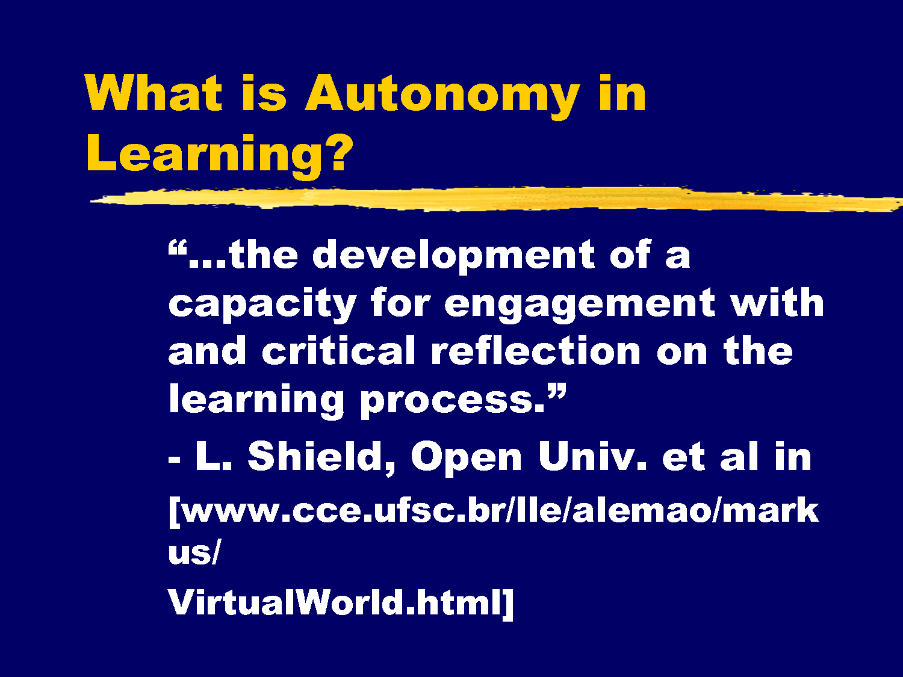
Autonomous Learning Approach

Slide 14

Grazie!

