Slide 1

The Nature of Problems –
Complexity

Slide 2
Didactic Suggestions (1)
These are only suggestions, any group of learners is free to experiment with the use of the micro-module. The types, number and order of use of the elements in the micro-module are open to choice. Depending on the learning strategy adopted, elements can be also eliminated or added. For this purpose, the micro-modules can be copied and modified.
(Ia) Try to start by connecting with the current state of knowledge and experience of the individual in the group/s.
Organize students into group/s of 4 or 5
(2) Ask the participants in the group/s to identify:
  (a) 2 problems they think are simple, and
  (b) 2 problems they think are complex.
Ask them to reflect: Why do they think the first 2 problems are simple and the second 2 problems are complex? What is it that differentiates them?
Ask the the groups to convene and share their results by selecting and presenting 2 “simple problems” and 2 “complex problems” per group. Then, they present their conclusions regarding “Why a problem is simple? and Why a problem is complex”

Slide 3
Didactic Suggestions (2)
(IIa) Use the micro-module “Nature of Problems - Complexity” to reinforce and deepen the understanding of the concept of Complexity in “Nature of Problems.”
Introduce the micro-module “Nature of Problems – Complexity” to the participants, explaining its multimedia, multi-dimensional, multi-role, multi-didactic intention. Explain that this is a more complex micro-module made up of several concepts.
Ask the participants in the group/s to explore individually the micro-module searching, focusing their attention and reflecting on those elements they find most effective in reinforcing and deepening their understanding of the concept of “Complexity” in the “Nature of Problems.”
The participants tell their groups about their first 3 choices of “most effective elements” and explain why they have selected them. The participants reflect collectively about their choices and their reasons. If some participants do not find the types of elements most appropriate to them, they can tell about those element and, even better, find them and contribute them to the micro-module.

Slide 4
Didactic Suggestions (3)
(IIb) Use the micro-module “Nature of the Problems” to reinforce and deepen the understanding of the concept of Complexity in “Nature of Problems.”
(4) Ask the participants in each group to return to the 2 simple and the 2 complex problems they identified in the first part of the activity and assess them individually using the instrument provided in the micro-module. Use one copy of the instrument per problem. The participants compare their individual assessments with those of the other members of the group. They discuss the reasons for the differences and agree on a group assessment, again using one copy of the instrument per problem.
(5) The groups convene and share their results, first, by selecting and presenting 3 choices of “most effective elements” per group, along with their conclusions as to why different people may have different preferences regarding elements and ways of learning; second, by presenting their collective assessment of the complexity of their selected problems and the reasons for this assessment. The groups discuss to see whether they arrive to a general agreement or a diversity of opinions prevails.
(6) Participants fill in the brief questionnaire about their preferences regarding the elements in the micro-module.

Slide 5
Nature of Problems
COMPLEXITY

Slide 6
Nature of Problems - COMPLEXITY
The COMPLEXITY of a problem is defined by the combination of 4 dimensions:
Amount of Knowledge Required
Difficulty of Grasping
ProblemComplexity
Amount of Steps to Arrive at Solution
.
Amount of Interrelations between Elements

Slide 7
Nature of Problems
Problems can vary in COMPLEXITY
Problems
Simple Problems
Complex Problems
Amount of Knowledge Required
The greater the amount knowledge required for its solution, the more complex is the problem and vice-versa.
Difficulty of Grasping
The more difficult are the concepts to grasp and apply, the more complex is the problem and vice-versa.
Amount of Steps to Arrive at Solution
The greater the number of steps required to arrive at a solution, the more complex is the problem and vice-versa.
Amount of Interrelations between Elements
The greater the amount of interrelations between the elements of a problem, the more complex is the problem and vice-versa

Slide 8
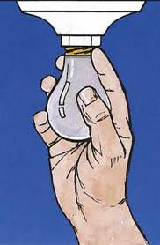
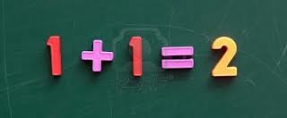
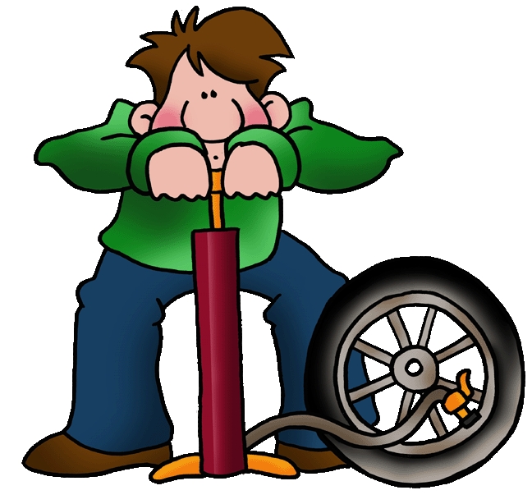
Nature of Problems
Problems can vary in COMPLEXITY
Simple
Complexity
Complex
SIMPLE PROBLEM
A problem is simple when its solution requires:
little knowledge or skills,
(b) concept is simple to grasp,
(c) small number of steps,
(d) little interrelations between elements.

Slide 9

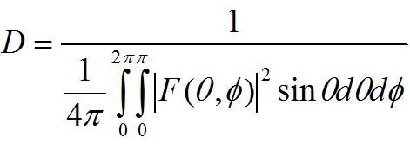
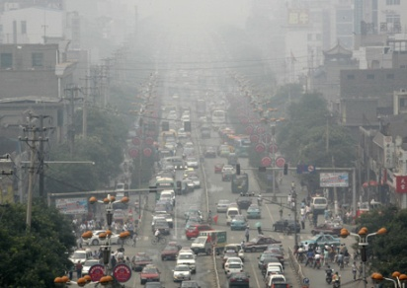
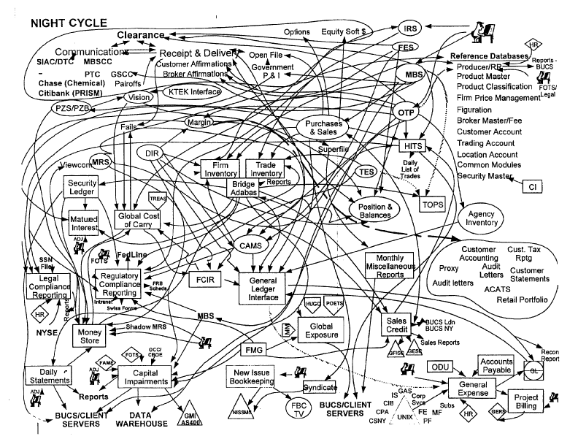
Nature of Problems
Problems can vary in COMPLEXITY
Simple
Complexity
Complex
COMPLEX PROBLEM
A problem is COMPLEX when its solution requires:
a wide amount of general and specific knowledge or skills (i.e., breath of knowledge),
(b) concepts are difficult to grasp and apply (i.e., attainment level of domain knowledge),
(c) a large number of steps, many of them complicated (i.e., intricacy of solution),
(d) large number of interrelations to be understood and processed (i.e., interrelatedned)

Slide 10

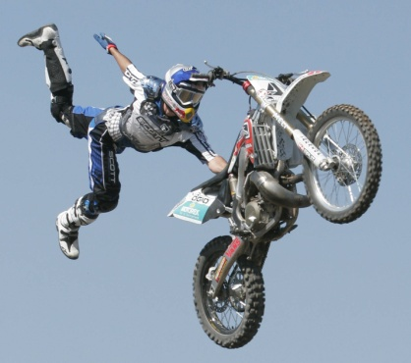

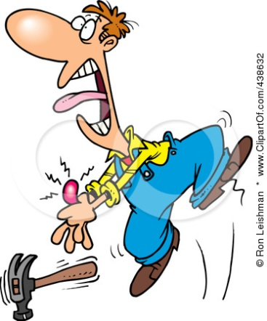
Nature of Problems
Problems can vary in the amount of knowledge or skills they require for solution
Little
Amount of Knowledgee
Lots

Slide 11

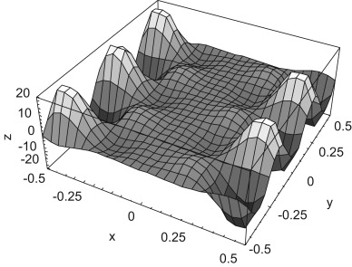
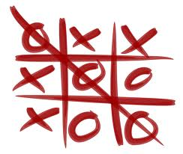
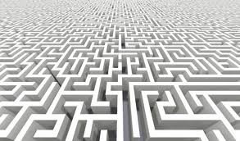

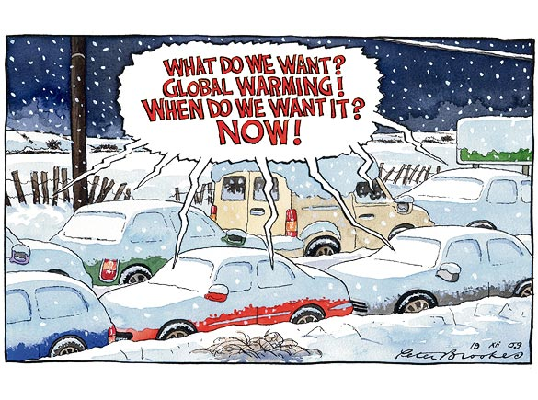
Nature of Problems
Problems can vary in the level of difficulty presented by their knowledge area – easy or difficult to grasp
Easy to grasp
Difficulty of grasping
Difficult to grasp

Slide 12

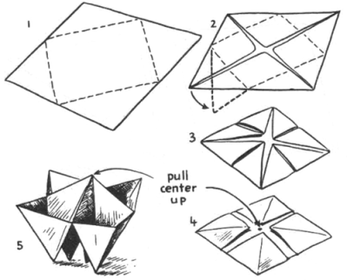

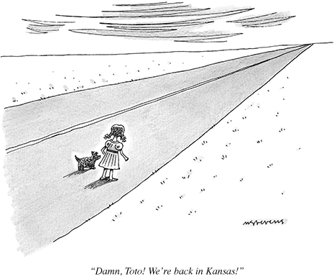
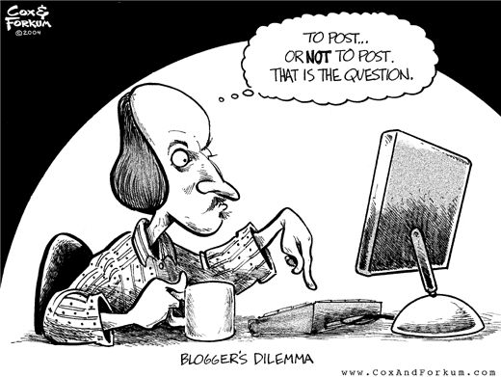
Nature of Problems
Problems can vary in the amount of steps required for their solution - level of intricacy
Few Steps
Amount of Steps
Multiple Steps

Slide 13
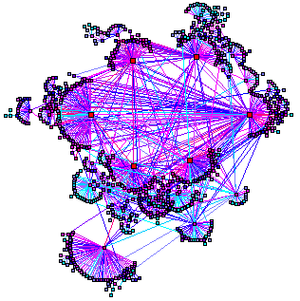
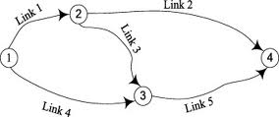
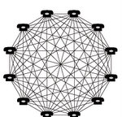


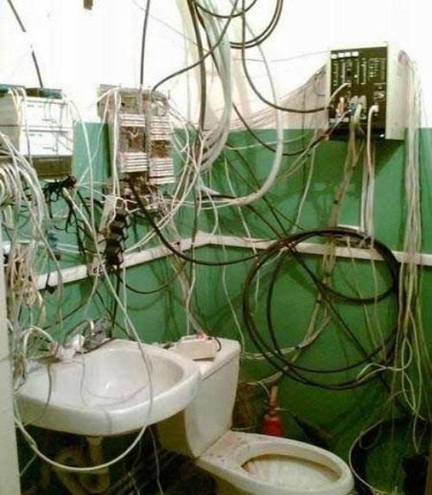
Nature of Problems
Problems can vary in the amount of interrelations between their components (variables) - level of interrelatedness
Few Relations
Amount of Interrelations
Multiple Interrelations

Slide 14

Complex Problem - Wisdom
My mind rebels at stagnation. Give me problems, give me work, give me the most abstruse cryptogram, or the most intricate analysis, and I am in my own proper atmosphere. But I abhor the dull routine of existence. I crave for mental exaltation.
Sir Arthur Conan Doyle
No matter how complicated a problem is, it usually can be reduced to a simple, comprehensible form which is often the best solution.
An Wang (BrainyQuotes)
If you break your neck, if you have nothing to eat, if your house is on fire, then you got a problem. Everything else is inconvenience.
Robert Fulghum
The future will present insurmountable problems - only when we consider them insurmountable.
Thomas S. Monson,
For every complex problem, there is a solution that is simple, neat, and wrong.
Henry Louis Mencken
We are continually faced by great opportunities brilliantly disguised as insoluable problems.
Lee Iacocca

Slide 15

Nature of Problems – Complexity
- Poetry
World Problems – Circumspection
When I look in the world There are some things that trouble me whether it be steroids, Facebook, or Twitter President Obama or the many wars. The world is in disarray from China, to England, and even the U.S. Everyone is trying to relieve the stress Every day is a struggle to get out of the problems
Nick Thomas

Slide 16
Nature of Problems
Instrument to Assess the COMPLEXITY of a Problem

Slide 17
Degree of Problem Simplicity / Complexity
Little knowledge
Breath of Knowledge
Lots of knowledge
1 | 2 | 3 | 4 | 5 | 6 | 7 | 8 | 9 | 10
Simple to grasp
Difficulty (Attainment) of Knowledge
Very difficult to grasp
1 | 2 | 3 | 4 | 5 | 6 | 7 | 8 | 9 | 10
Small number of steps
Intricacy
Lots of complicated steps
1 | 2 | 3 | 4 | 5 | 6 | 7 | 8 | 9 | 10
Few interrelations
Interrelatedness
Lots of interrelations
1 | 2 | 3 | 4 | 5 | 6 | 7 | 8 | 9 | 10
Total:
Simple
Highly complex
Problem Complexity = Total / 4
1 | 2 | 3 | 4 | 5 | 6 | 7 | 8 | 9 | 10

Slide 18
Brief Questionnaire
How do you rate the usefulness of the following elements for your learning?
 | Very Low | Low | Moderate | High | Very High
Definition
Wisdom
Fun
Poetry
Assessment Instrument
What other elements would you like to see in the micro-module?

Slide 19
Acknowledgements
Developed by
Alfonso Molina
Sources
Various works by David Jonassen
Various Quotation Websites
Various Poetry Websites
Various websites with images relating to the concept of Problem

