Slide 1
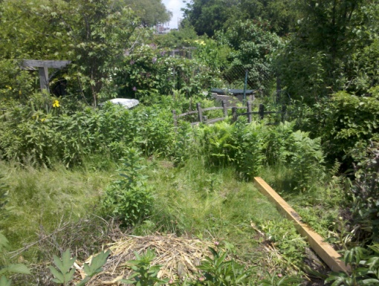
The Nature of Problems -
Structure

Slide 2
Didactic Suggestions (1)
These are only suggestions, any group of learners is free to experiment with the use of the micro-module. The types, number and order of use of the elements in the micro-module are open to choice. Depending on the learning strategy adopted, elements can be also eliminated or added. For this purpose, the micro-modules can be copied and modified.
Ia) Try to start by connecting with the current state of knowledge and experience of the individual in the group/s. Ask the participants if they can distinguish between the complexity (simple / complex) and the structure (well-structured / ill-structured) of a problem. If so, follow the steps below. If the participants are not able to distinguish the difference, then it is better to use the micro-module.
Organize students into group/s of 4 or 5
(2) Ask the participants in the group/s to identify:
(a) 2 problems they think are well-structured, and
(b) 2 problems they think are ill-structured.
Ask them to reflect: Why do they think the first two problems are well-structured and the second two problems are ill-structured? What is it that differentiates them?
Ask the the groups to convene and share their results by selecting and presenting 2 “well-structured problems” and 2 “ill-structured problems” per group. Then, they present their conclusions regarding “Why a problem is well-structured? and Why a problem is ill-structured”?

Slide 3
Didactic Suggestions (3)
(IIa) Use the micro-module “Nature of the Problems - Structure” to reinforce and deepen the understanding of the concept of Structure in “Nature of Problems.”
Introduce the micro-module “Nature of Problems - Structure” to the participants, explaining its multimedia, multi-dimensional, multi-role, multi-didactic intention. Explain that this is a more complex micro-module made up of several concepts.
Ask the participants in the group/s to focus first on the concept of Structure and explore individually the micro-module searching, focusing their attention and reflecting on those elements they find most effective in reinforcing and deepening their understanding of the concept of “Structure” in the “Nature of Problems.”
The participants tell their groups about their first 3 choices of “most effective elements” and explain why they have selected them. The participants reflect collectively about their choices and their reasons. If some participants do not find the types of elements most appropriate to them, they can tell about those element and, even better, find them and contribute them to the micro-module.

Slide 4
Didactic Suggestions (4)
(IIb) Use the micro-module “Nature of Problems - Structure” to reinforce and deepen the understanding of the concept of Structure in “Nature of Problems.”
(4) Ask the participants in each group to return to the 2 well-structured and the 2 ill-structured problems they identified in the first part of the activity and assess them individually using the instrument provided in the micro-module. Use one copy of the instrument per problem. The participants compare their individual assessments with those of the other members of the group. They discuss the reasons for the differences and agree on a group assessment, again using one copy of the instrument per problem.
(5) The groups convene and share their results, first, by selecting and presenting 3 choices of “most effective elements” per group, along with their conclusions as to why different people may have different preferences regarding elements and ways of learning; second, by presenting their collective assessment of the structure of their selected problems and the reasons for this assessment. The groups discuss to see whether they arrive to a general agreement or a diversity of opinions prevails.
(6) Participants fill in the brief questionnaire about their preferences regarding the elements in the micro-module.

Slide 5
Nature of Problems
Structure

Slide 6
Nature of Problems - STRUCTURE
The STRUCTURE of a problem is defined by the combination of 5 dimensions:
Transparency
Heterogeneity of Interpretation
Problem Structure
Dinamicity
Legitimacy of Competing Alternatives
Interdisciplinarity

Slide 7
Nature of Problems
Problems can vary in STRUCTURE
Problems
Well-structured Problems
Ill-structured Problems
Transparency
The more we know about the problems (and problem area), the better structured, transparent and easier they are.
Heterogeneity of Interpretations
The less open to different interpretations is the understanding or solutions of problems, the better structured and easier they are.
Dinamicity
The greater the stability and continuity of problems, the better structured and easier to comprehend they are.
Interdisciplinarity
The lower the interdisciplinarity of problems, the better structured and easier to comprehend, they are.
Legitimacy of Competing Alternatives
The lower the number of conceivable solution paths to problems, the better structured and easier they are.

Slide 8
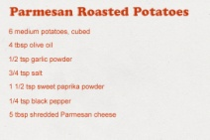
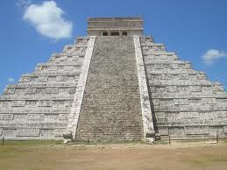
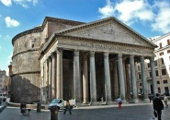
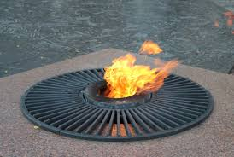
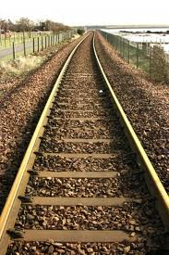
Nature of Problems
Problems can vary in STRUCTURE
Well-structured
Structuredness
Ill-structured
WELL-STRUCTURED PROBLEM
A problem is well structured when:
all necessary knowledge is known
it is open to a single interpretation
it belongs to a single discipline
it does not change with time (stable)
it has a single solution path

Slide 9
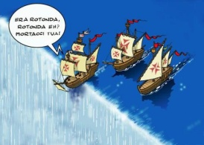
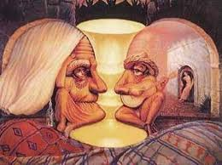
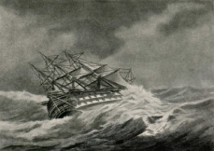
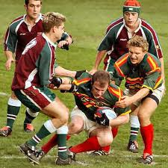
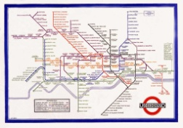
Nature of Problems
Problems can vary in STRUCTURE
Well-structured
Structuredness
Ill-structured
ILL-STRUCTURED PROBLEM
A problem is ILL-STRUCTURED when:
it has many unknown areas
(b) it is open to many possible interpretations
(c) it involves a large number of disciplines
(d) it is highly dynamic (unstable) in time
(e) it has a large number of conceivable solution paths

Slide 10
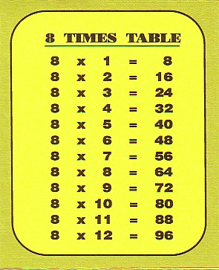
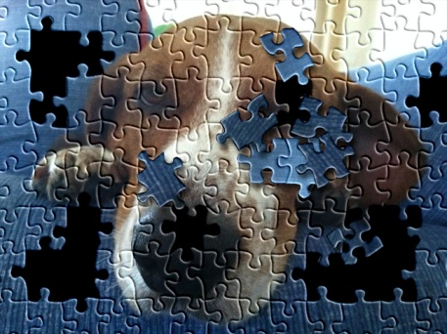
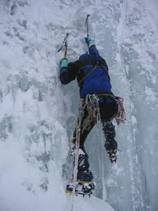
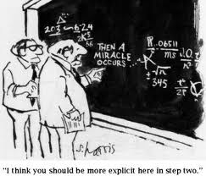
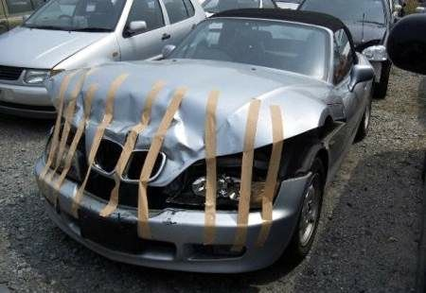
Nature of Problems
Problems can vary in the amount of known or unknown knowledge areas
All known
Known /Unknown Areas
Many unknowns

Slide 11
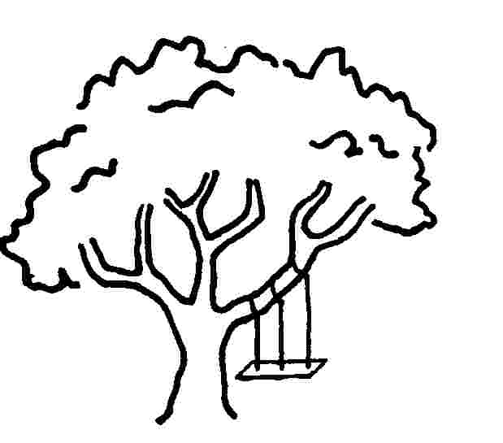
Nature of Problems
Problems can vary in the amount of interpretations they can have
One interpretation
Interpretations
Multiple interpretations
Maintenance
Management
How they Interpreted the Swing
Marketing
Manufacturing
Engineering
Customer

Slide 12
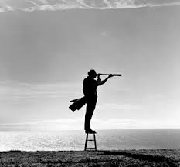
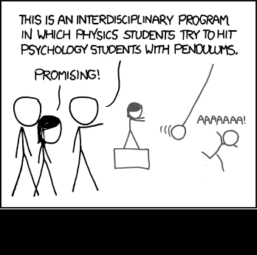
Nature of Problems
Problems can vary in the amount of disciplines involved
One discipline
Interdisciplinarity
Multiple disciplines

Slide 13
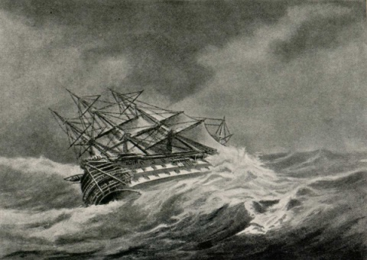
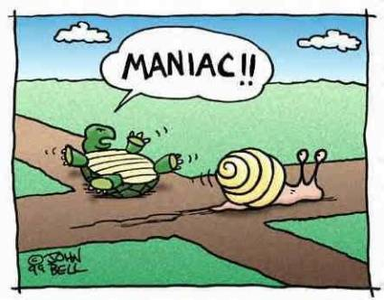
Nature of Problems
Problems can vary in the amount of dynamicity (stability) they have in time
Stable
Dinamicity
Unstable

Slide 14
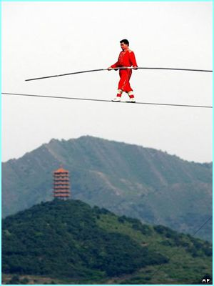
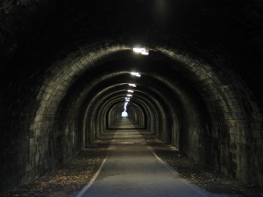
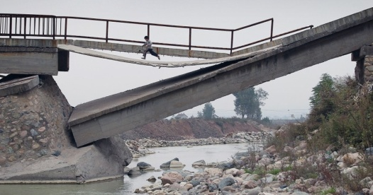
Nature of Problems
Problems can vary in the amount of solution paths they have
Single path
Amount of Solution Paths
Multiple paths

Slide 15
Nature of Problem – Well-Structured / Ill-Structured (Wisdom)
UNKNOWNS: Prepare for the unknown by studying how others in the past have coped with the unforeseeable and the unpredictable.
George S. Patton
INTERPRETATION: Everyone in a complex system has a slightly different interpretation. The more interpretations we gather, the easier it becomes to gain a sense of the whole.
Margaret J. Wheatley
DYNAMISM: A free society is not calm and eventless place - that is the kind of static, dead society dictators try to create. Free societies are dynamic, noisy, turbulent, and full of radical disagreements.
Salman Rushdie
MULTIPLE PATHS: The future is not some place we are going to, but one we are creating. The paths are not to be found, but made, and the activity of making them, changes both the maker and the destination.
John Schaar
INTERDISCIPLINARITY: So much of new knowledge and new applications and ideas come when people from different disciplines combine their expertise or their ways of thinking and looking at problems to discover new solutions, ... If we could begin to do that kind of thing and foster the collective growth in many different fields that we are involved in, I think it would be a lot more fun, as well as a lot more productive.
Eric Roberts

Slide 16
POEM related to Multiple Paths to Solutions
Roads Go Ever On
Roads go ever ever on,
Over rock and under tree,
By caves where never sun has shone,
By streams that never find the sea;
Over snow by winter sown,
And through the merry flowers of June,
Over grass and over stone,
And under mountains in the moon.
Roads go ever ever on,
Under cloud and under star.
Yet feet that wandering have gone
Turn at last to home afar.
Eyes that fire and sword have seen,
And horror in the halls of stone
Look at last on meadows green,
And trees and hills they long have known.
The Road goes ever on and on
Down from the door where it began.
Now far ahead the Road has gone,
And I must follow, if I can,
Pursuing it with eager feet,
Until it joins some larger way,
Where many paths and errands meet.
The Road goes ever on and on
Down from the door where it began.
Now far ahead the Road has gone,
And I must follow, if I can,
Pursuing it with weary feet,
Until it joins some larger way,
Where many paths and errands meet.
And whither then? I cannot say.
The Road goes ever on and on
Out from the door where it began.
Now far ahead the Road has gone.
Let others follow, if they can!
Let them a journey new begin.
But I at last with weary feet
Will turn towards the lighted inn,
My evening-rest and sleep to meet.”
J.R.R. Tolkien (The Lord of the Rings)

Slide 17
Nature of Problems
Instrument to Assess the STRUCTURE of a Problem

Slide 18
Degree of Problem Structuredness - Well-structured / Ill-structured
All known
Transparency
Many unknowns
1 | 2 | 3 | 4 | 5 | 6 | 7 | 8 | 9 | 10
Single interpretation
Heterogeinity of Interpretations
Many interpretations
1 | 2 | 3 | 4 | 5 | 6 | 7 | 8 | 9 | 10
Single discipline
Interdisciplinarity
Many disciplines
1 | 2 | 3 | 4 | 5 | 6 | 7 | 8 | 9 | 10
Stable
Dynamicity
Highly dynamic
1 | 2 | 3 | 4 | 5 | 6 | 7 | 8 | 9 | 10
Single solution path
Competing Alternatives Solutions
Many solution paths
1 | 2 | 3 | 4 | 5 | 6 | 7 | 8 | 9 | 10
Total:
Well-structured
Problem Structure = Total / 5
Ill-structured
1 | 2 | 3 | 4 | 5 | 6 | 7 | 8 | 9 | 10

Slide 19
Brief Questionnaire
How do you rate the usefulness of the following elements for your learning?
 | Very Low | Low | Moderate | High | Very High
Definition
Wisdom
Fun
Poetry
Assessment Instrument
What other elements would you like to see in the micro-module?

Slide 20
Acknowledgements
Developed by
Alfonso Molina
Sources
Various works by David Jonassen
Various Quotation Websites
Various Poetry Websites
Various websites with images relating to the concept of Problem

