Slide 1
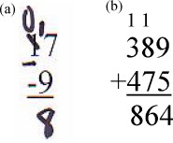
Types of Problems

Slide 2
Didactic Suggestions (1)
These are only suggestions, any group of learners is free to experiment with the use of the micro-module. The types, number and order of use of the elements in the micro-module are open to choice. Depending on the learning strategy adopted, elements can be also eliminated or added. For this purpose, the micro-modules can be copied and modified.
(Ia) Try to start by connecting with the current state of knowledge and experience of the individual in the group/s.
Organize students into group/s of 4 or 5
Ask the participants in the group/s to:
(a) give examples of problems they think are of a different kind (as many as possible)
(b) produce a list and, for every class of problem, identify the main characteristic.
Ask them to reflect: Why do they think the problems belong to different classes? Is there any relationship with the concepts of Complexity and Structure of problems?
Ask the groups to convene and share their results by presenting their lists of problems along with the main characteristics justifying the classification. Do the lists and main characteristics identified by the different groups coincide? If not, add up the lists, discuss the differences and produce a consensus list.
Ask the groups to select at random 2 problems from the news and discuss whether they belong to a single category or they contain different classes of problems. Identify them.

Slide 3
Didactic Suggestions (2)
(II) Use the micro-module “Types of Problems” to reinforce and deepen the understanding of the concept of “Types of Problems.”
Introduce the micro-module “Types of Problems” to the participants, explaining its multimedia, multi-dimensional, multi-role, multi-didactic intention.
Ask the participants in the group/s to explore the micro-module searching, focusing their attention and reflecting on those elements they find most effective in reinforcing and deepening their understanding of the concept of “Types of Problems.”
The participants tell their groups about their first three choices of “most effective elements” and explain why they have selected them. The participants reflect collectively about their choices and their reasons. If some participants do not find the types of elements most appropriate to them, they can tell about those element and, even better, find them and contribute them to the micro-module.
The groups convene and share their results by selecting and presenting 3 choices of “most effective elements” per group, along with their conclusions as to why different people may have different preferences regarding elements and ways of learning.
Participants fill in the brief questionnaire about their preferences regarding the elements in the micro-module.

Slide 4
Types of Problems
Definitions

Slide 5
Types of Problems
There are several types or classes of problems. One of the best typologies is shown here. It is the result of the work of David Jonassen. There are others typologies.
Types of Problems
Dilemma problems
Logic problems
Design problems
Algoritm problems
Policy-analysis problems
Story (word) problems
Strategic performance problems
Rule-using problems
Decision-making problems
Diagnosis-Solution problems
Troubleshooting problems
Warning: it is important to note that the different classes or categories of problems are not completely discrete or mutually exclusive. There are overlaps and similarities between them.

Slide 6
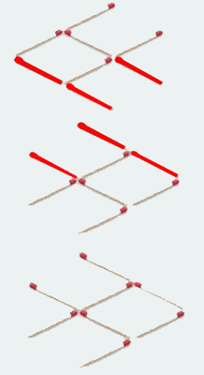
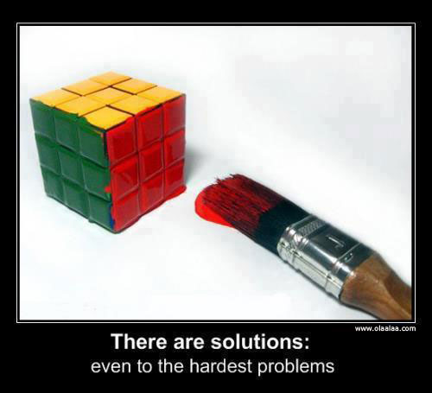
Types of Problems – Logic Problems
Logic Problems
Logic problems tend to be tests of logic that puzzle the learner. They imply the manipulation of limited elements or variables such as in solving a puzzle. The learner has to discover a specific method of reasoning that yield the most efficient solution.
(Jonassen, 2011a book, p.12)

Slide 7
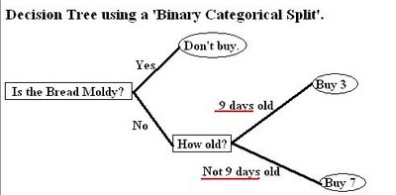
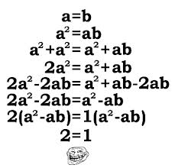
Types of Problems – Algorithms
Algorithms
Algorithms are procedures or sequence of steps (manipulations) to calculate or produce correct answers. They are common in math and science at school where they require number comprehension, number production, and calculation.

Slide 8
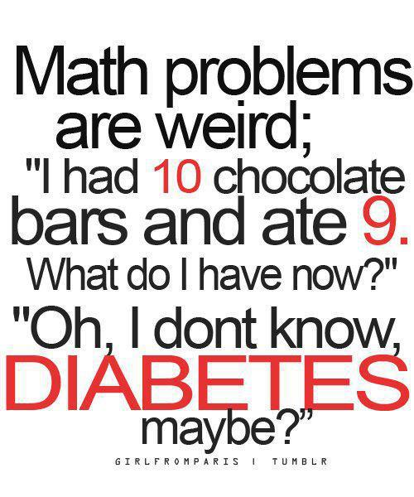
Types of Problems – Story Problems
Story Problems
Story problems embed an algorithm problem into a brief story. They provide a context to the algorithm and learners solve them by (1) identifying key words in the story, (2) selecting the appropriate algorithm and sequence for solving the problem, and (3) applying the algorithm to find the value of the unknown variable. Story problems are also known as word problems.
Adress costs $150.It was marked down 20% and there was a 10% sale tax. What was the final cost of the dress?
There were18 girls and 15 boys on the track team. 7 more girls joined the team. 4 boys quit the team. How many children were on the track team then?

Slide 9
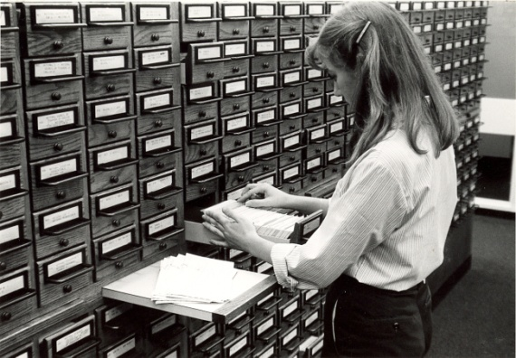
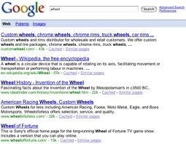
Types of Problems – Rule-using Problems
Rule Using/ Rule Induction Problem
Rule using problems have the clear purpose or goal of finding the most relevant information or product sources in the least amount of time. They are constrained but not restricted to a specific procedure or method as in the case of using an online search system or library catalogue to find scientific information.

Slide 10
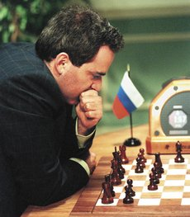
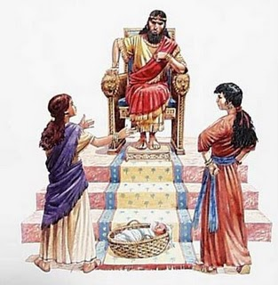
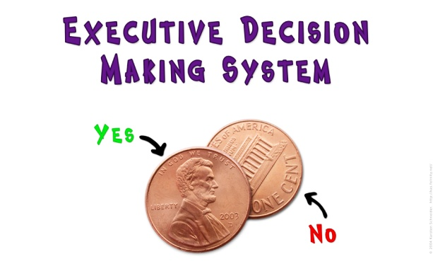
Types of Problems – Decision-making Problems
Decision-Making Problems
Decision-making problems involves the selection of a solution from a set of alternative solutions. One or several criteria are used to identify the best solution. Those criteria may be provided to, or they must be identified by, the decision-maker.

Slide 11
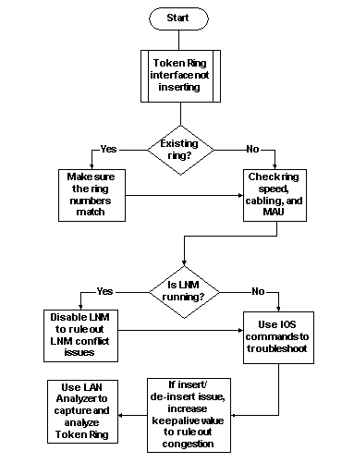
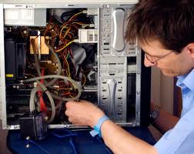
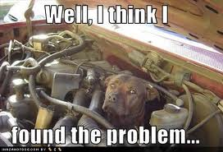
Types of Problems – Troubleshooting Problems
Troubleshooting Problems
Troubleshooting problems involve diagnosis, maintenance and repairing faulty (dysfunctional) systems and processes, including medical and psychological cases. Troubleshooting requires conceptual models of the systems, their components and interactions, along with knowledge of fault characteristics, symptoms, contextual information, and probabilities of occurrence. It is commonly taught as a procedure.

Slide 12
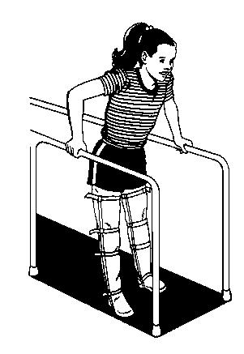
Types of Problems – Diagnosis-Solution Problems
Diagnosis-Solution Problem
Diagnosis-solution problems are initially very similar to troubleshooting since, as first steps, they require the identification of a faulty condition. The difference is in the solution strategies that in troubleshooting are restricted since the goal is to repair and get the system back working quickly. Instead in diagnosis-solutions problems (e.g., a sick person), there are multiple solution strategies frequently depending on contextual factors and the history of the patient (e.g., the therapy or solution strategy will depend on the patient, the medical institution, the insurance company, and others).

Slide 13
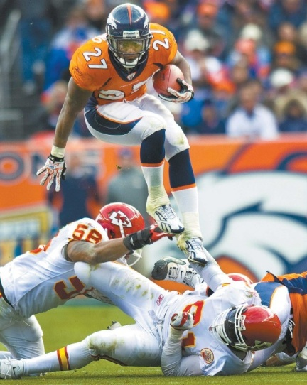
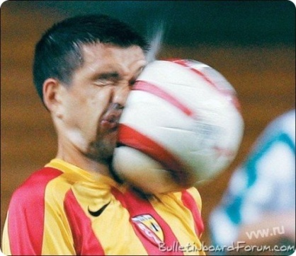
Types of Problems – Strategic Performance Problems
Strategic Performance Problems
Strategic performance problems involve real-time, complex activity from performers (problem solvers) who apply a number of tactical activities to meet strategic objectives, usually under significant time pressure. An expert performer has the ability to improvise or construct new tactics on the spot to meet the strategy.

Slide 14
Types of Problems – Policy Problems (Case Analysis)
Policy Problem
Policy problems concern the solution of social ills and commonly involve complex, multi-faceted issues on which multiple positions and perspectives exist. Policy problems are not always clear and different stakeholders can have different views about them. Context is essential in policy problems (contextually situated) and their solutions demand a deep analysis of contextual factors. The solutions also demand the articulation of the different perspectives in order to, first, define the effective problems an, then, suggest the proper solutions.

Slide 15
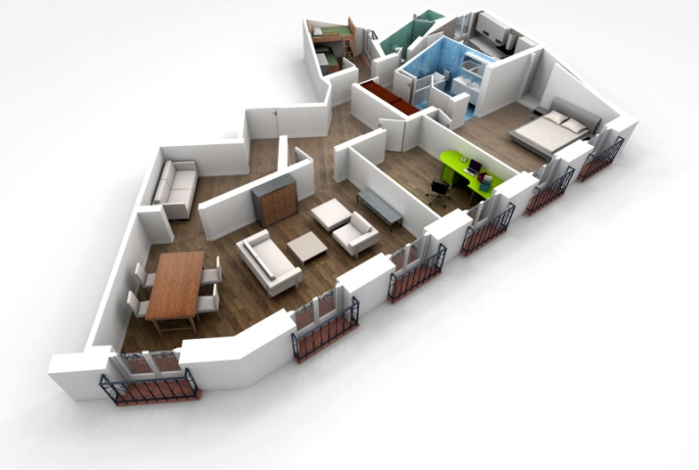
Types ofProblems–Design Problems
Design Problems
Design problems involve the creation of new products, processes, services such as cars, buildings and industrial processes. Design problems seek the apparent goal of finding an optimal solution within determined constraints. However, they usually are very domain specific and have vaguely defined or unclear goals, multiple solution paths, and unstated constraints. They also possess multiple criteria for evaluating solutions, and these criteria are highly subjective and often unknown until the end of the process.

Slide 16
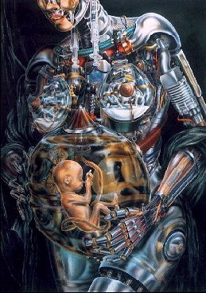
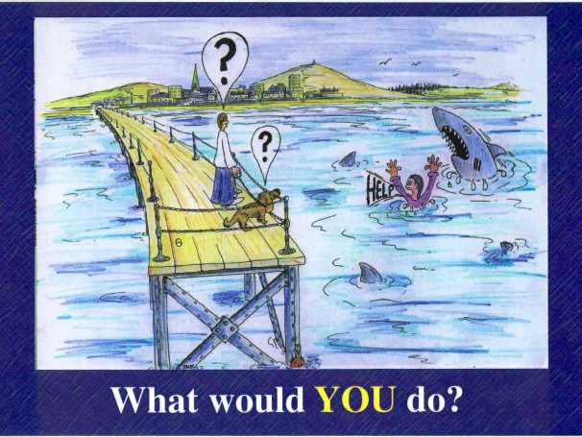
Types ofProblems– Dilemmas
Dilemmas
Dilemmas are problems that require choices between mutually exclusive and equally undesirable options. They do not have solutions acceptable to all the people affected by the problem. There will always be a significant proportion of people unhappy with a solution. They are complex and non-predictive.

Slide 17
Types of Problems
Spectrum of Complexity and Structure

Slide 18
Types of Problems – Complexity & Structure
Jonassen argues that, in general, moving from left to right, the problems change from well-structured and static to ill-structured and dynamic
Types of Problems
Dilemma problems
Logic problems
Design problems
Algoritm problems
Policy-analysis problems
Story (word) problems
Strategic performance problems
Rule-using problems
Decision-making problems
Diagnosis-Solution problems
Troubleshooting problems
Well-structured
Staticand simpler
Ill-structured
Dynamicand complex

Slide 19
Types of Problems
Combinations or Aggregates

Slide 20
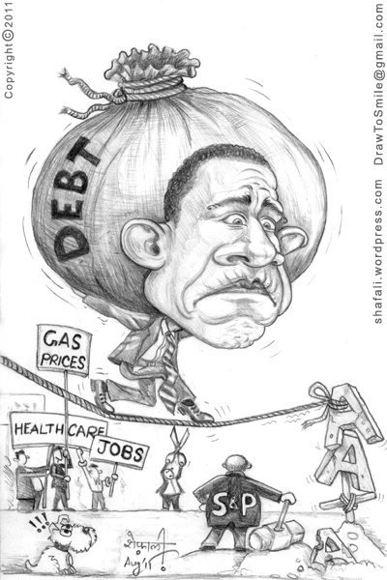
Combinations or Aggregates of Problems
Frequently in real life, people deal with problem situations containing combinations or aggregates of well-structured and ill-structured problems. The case of facing single separate or discrete problems is most commonly found in schools or other formal education institution.
Possible Real-life Problem
Dilemma problems
Strategic performance problems
Decision-making problems
Design problems
Diagnosis-Solution problems
Rule-using problems
Policy-analysis problems

Slide 21
BriefQuestionnaire
How do you rate the usefulness of the following elements for your learning?
 | Very Low | Low | Moderate | High | Very High
Definition
Wisdom
Fun
Poetry
What other elements would you like to see in the micro-module?

Slide 22
Acknowledgements
Developed by
Alfonso Molina
Sources
Various works by David Jonassen
Various Quotation Websites
Various Poetry Websites
Various websites with images relating to the concept of Problem

