Slide 1
5Ms – “Fivems”
Multimedia,
Multi-dimensional,
Multi-role,
Multi-didactic
Micro-modules
.

Slide 2
Multimedia, Multi-dimensional, Multi-role, Multi-didacticMicro-modules (5Ms – “Fivems”)
5Ms are didacticensemblesofknowledgeobjectsaiming at facilitatinglearning - or evenbetterlearning-to-learn–ofspecificwell-definedconcepts, methods and activities.
5Ms are pedagogically, cognitively and technologically innovative and seektoprovideknowledgeofpracticalvalue inside the processofeducationfor life.
5Ms are pedagogically “provocative” in the sensethattheymuststimulate and empower the learnersto take property and buildtheirownlearningpaths.
5Ms are multimedia, multi-dimensional, multi-role and multi-didactic.

Slide 3
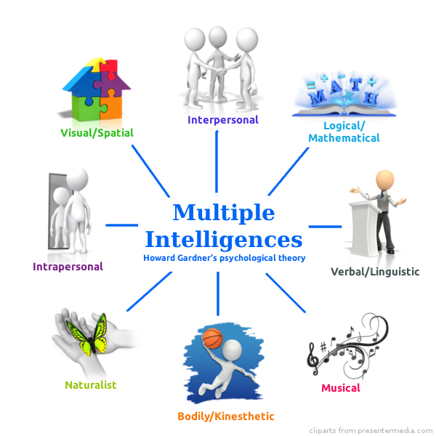
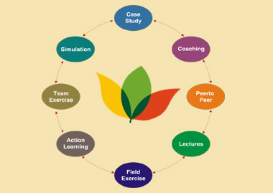
5Ms (“Fivems”) Approach
Multimedia, Multi-role, Multi-dimensional, Multi-didactic Micro-modules
Multimedia
Multi-dimensional
5Ms
Multi-didactic
Multi-role

Slide 4
5Ms (“Fivems”) - Multimedia
5Ms are multimedia since they blend knowledge objects using videos, audio, text, tools, games, exercises, templates, etc.
Multimedia
5Ms

Slide 5
5Ms (“Fivems”) - Multi-dimensional
5Ms are multi-dimensional since they address the rich human cognitive richness possibilities by blending multiple forms of knowledge, arts, fun and any other possibility.
Multi-dimensional
5Ms

Slide 6
5Ms (“Fivems”) - Multi-role (“Multiple Hats”)
5Ms are multi-role since they allow the learners to play diverse (desired) roles inside learning groups, for instance, creative, energizer, developer, explorer, troubleshooter, reporter, poet, comedian, etc.
5Ms
Multi-role

Slide 7
5Ms (“Fivems”) - Multi-didactic
5Ms are multi-didactic since they facilitate the selection and application of multiple didactic paths to stimulate the most effective forms of learning in accordance with the attributes of learning individual or groups, including teachers, learners and self-learners
5Ms
Multi-didactic

Slide 8
Thanks!

