Slide 1
5Ms – “Fivems” Use Approaches
.

Slide 2
General Approach to the Use of 5Ms
The use 5Ms must be seen in two forms:
individually - as single didactic micro-modules focused on specific concepts.
grouped - as sets of didactic micro-modules focused on themes (ensembles of concepts) and learning paths (courses).
5M
5M
5M
5M
5M
5M
5M
5M
5M
In both cases, the coordinators, animators, moderators, coaches of the learning processes (teachers and self-learners) can choose between (a) pre-defined structured approaches, (b) open self-organizing approaches, and (c) mixes of the two.

Slide 3
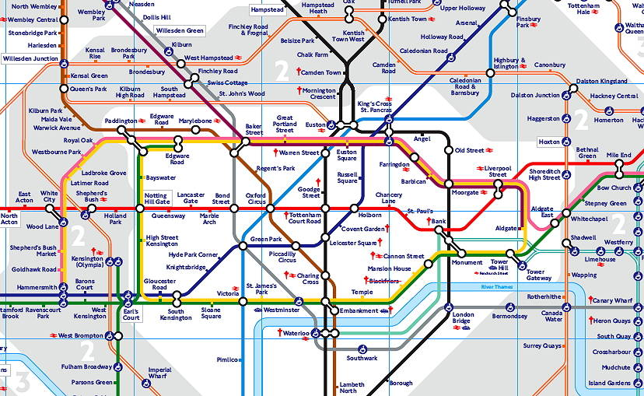
Open Self-organizing Approaches
In open self-organizing approaches, the coordinators, animators, moderators, coaches of the learning processes (teachers and self-learners) stimulate and support learners to find their own learning paths into the concepts and themes to be learnt or problems to be solved. In this approach learners have better defined points of arrival than points of entrance and learning paths. Learners select 5Ms in the amount and order they wish, depending on their motivations, learning styles and requirements (constraints). Like in the Metro (Tube) they can chose the points of entrance, the paths to be followed, and the exits for the journey. Teachers act as mentors, consultants, energizers, etc.

Slide 4
Pre-defined Structured Approaches
In pre-defined structured approaches, the coordinators, animators, moderators, coaches of the learning processes stimulate and support learners to follow a single learning paths into the concepts and themes to be learn or problems to be solved. In this approach, learners have well defined points of entrance, learning paths and points of arrival. Teachers select the amount, order and content of 5Ms, in accordance with their preferred didactic approaches and requirements (constraints). Like in a maze the learners have single points of entrance, a single path to be followed, and a single exit for the journey. Teachers act as directors, energizers, supporters, controllers, etc.

Slide 5
Mixed Structured / Self-organizing Approaches
In between the extremes cases of completely structured and completely self-organizing approaches, it is possible to conceive a huge amount of possible combinations of the two approaches. It will be up to the coordinators, animators, moderators, coaches of the learning processes to envision and define the mix and prompt the learners to follow the mixed learning paths into the concepts and themes to be learn or problems to be solved. At various times, teachers act as directors, energizers, supporters, mentors, consultants, controllers.

Slide 6
Thanks!

