Slide 1
Problem Solver

Slide 2
Didactic Suggestions (1)
These are only suggestions, any group of learners is free to experiment with the use of the micro-module. The types, number and order of use of the elements in the micro-module are open to choice. Depending on the learning strategy adopted, elements can be also eliminated or added. For this purpose, the micro-modules can be copied and modified.
(Ia) Try to start by connecting with the current state of knowledge and experience of the individual in the group/s.
Organize students into group/s of 4 or 5
Ask the participants in the group/s to:
(a) give 2 examples of situations in which they acted as problem solvers, first, individually and, second, as members of a group.
(b) reflect on the capacities or attributes that enabled (a) the individual and (b) the group to act as effective problem solvers. List and define the capacities.
Ask them to reflect: Is there a difference between the capacities of an individual problem solver and a problem-solver group?
Ask the groups to convene and share their results by presenting their lists and definitions of problem-solver capacities. Do the lists and definitions identified by the different groups coincide? If not, add up the lists, discuss the differences and produce a consensus list.
Ask each of the groups to select two problems –one relating to the school, the other from the news- and use the instrument provided in the micro-module to assess the problem-solver capacities of the groups in relation to the selected problems. Use one copy of the instrument per problem. The groups compare and discuss the reasons for their respective assessments .

Slide 3
Didactic Suggestions (2)
(II) Use the micro-module “Problem Solver” to reinforce and deepen the understanding of the concept of “Problem Solver.”
Introduce the micro-module “Problem Solver” to the participants, explaining its multimedia, multi-dimensional, multi-role, multi-didactic intention.
Ask the participants in the group/s to explore the micro-module searching, focusing their attention and reflecting on those elements they find most effective in reinforcing and deepening their understanding of the concept of “Problem Solver.”
The participants tell their groups about their first three choices of “most effective elements” and explain why they have selected them. The participants reflect collectively about their choices and their reasons. If some participants do not find the types of elements most appropriate to them, they can tell about those element and, even better, find them and contribute them to the micro-module.
The groups convene and share their results by selecting and presenting 3 choices of “most effective elements” per group, along with their conclusions as to why different people may have different preferences regarding elements and ways of learning.
Participants fill in the brief questionnaire about their preferences regarding the elements in the micro-module.

Slide 4
Types of Problems
Definitions

Slide 5
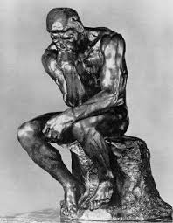
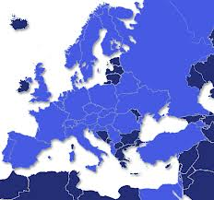
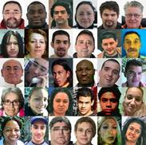
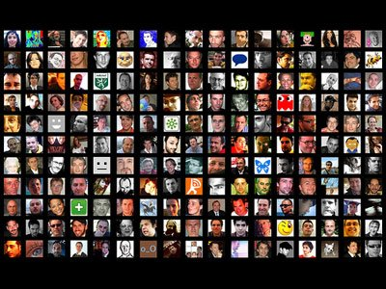
The Problem Solver/s
“.. a problem only exists if people (e.g., an individual, social groups, or societies) perceives it as such, that is, they believe that it is worth finding the unknown and close the gap between the existing and the desired situations (David Jonassen)
The solution to a problem requires of problem solvers who can be individuals or social groups of any size (even societies).

Slide 6
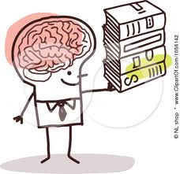
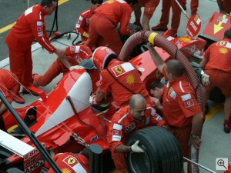
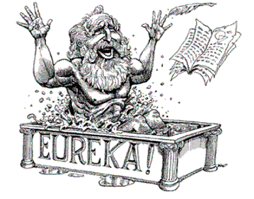
Main Attributes of the Problem Solver/s
Prior knowledge of the problem area
Prior experience of solving similar problems
Ability of problem solvers is defined by at least four characteristics
Cognitive skills (e.g., critical thinking, causal reasoning)
Motivation (e.g., will and confidence to engage, invest & persist

Slide 7
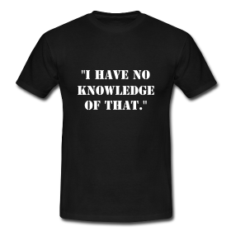
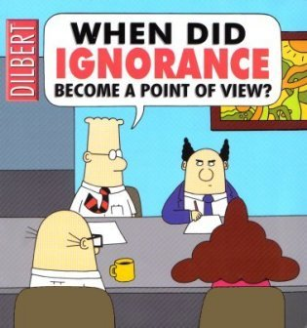
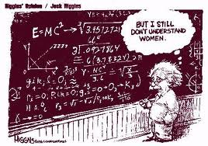
Main Attributes of the Problem Solver/s
Problem solvers can vary in the amount of prior knowledge the have on the problem area
Little knowledge
Prior Knowledge of Problem Area
Lots of knowledge

Slide 8
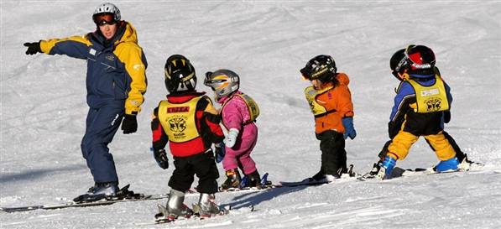
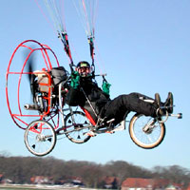
Main Attributes of the Problem Solver/s
Problem solvers can vary in the amount of experience they have of similar problems
Little experience
Prior Experience Similar Problem
Lots of experience

Slide 9
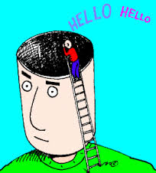
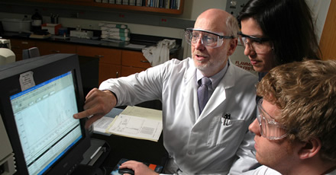
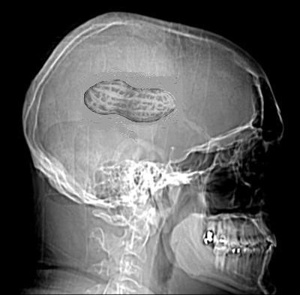
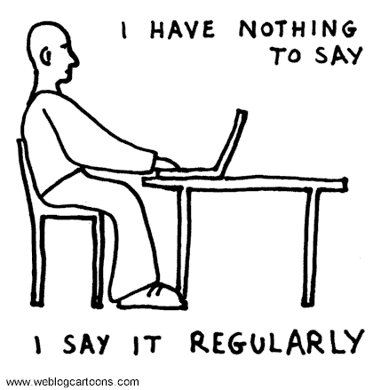
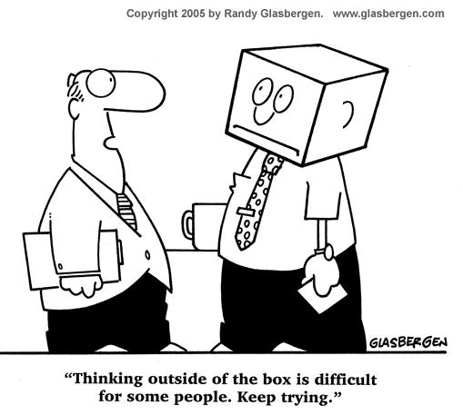
Main Attributes of the Problem Solver/s
Problem solvers can vary in the amount of cognitive skills they have
Little cognitive skills
Amount of Cognitive Skills
Lots of cognitive skills

Slide 10
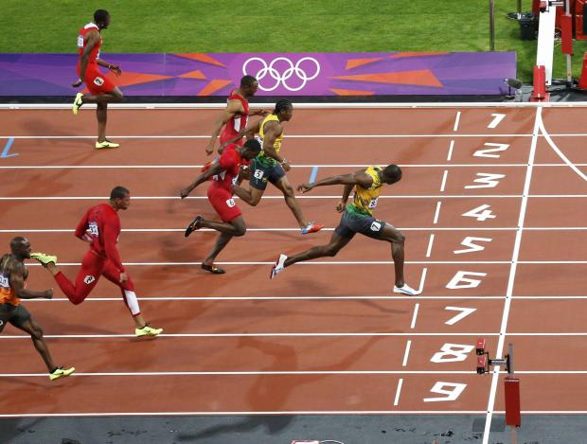
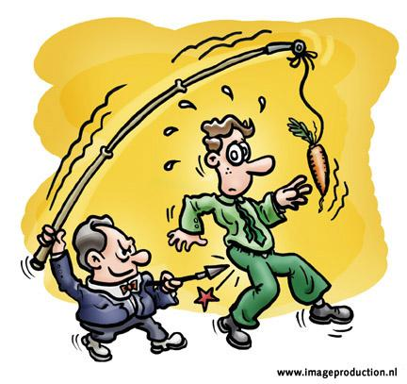
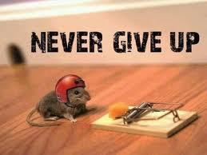
Main Attributes of the Problem Solver/s
Problem solvers can vary in the amount of motivation they have
Very Low Motivation
Amount of Motivation
Very High Motivation

Slide 11
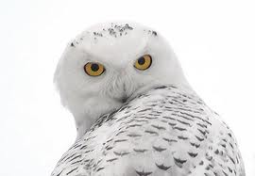
Problem Solver Attributes - Wisdom
It isn't that they can't see the solution. It's that they can't see the problem.
Gilbert K. Chesterton
Many of life’s failures are people who did not realize how close they were to success when they gave up.
Thomas Edison
It's not a problem that we have a problem. It's a problem if we don't deal with the problem.
Mary Kay Utech
In the confrontation between the stream and the rock, the stream always wins - not through strength, but through persistence.
Buddha
Responsibility is the most powerful internal motivator for problem solving. When you remove it, all that remains is the lesser drive of self-preservation. If necessity is the mother of invention then responsibility is its father.
Mark A. Crouch
The problem is not the problem. The problem is your attitude about the problem. Do you understand?
Captain Jack Sparrow

Slide 12
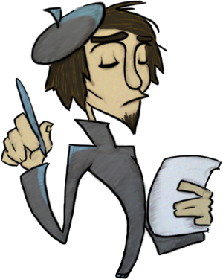
Problem Solver - Poetry
Somebody, Anybody and Nobody
There was an important job to be done and Everybody was sure that Somebody would do it. Anybody could have done it, but Nobody did it. Somebody got angry about that because it was Everybody's job.
Everybody thought that Anybody could do it, but Nobody realized that Everybody wouldn't do it.
It ended up that Everybody blamed Somebody when Nobody did what Anybody could have done. Anonymous Author
A Simple Truth
The hills, the valleys of this land Are not so hard to understand. If we perceive with childish eyes, We can make happy and true the skies.
David Lacey

Slide 13
Problem Solver Attributes and Success Potential
Little knowledge
Prior Knowledge
Lots of knowledge
1 | 2 | 3 | 4 | 5 | 6 | 7 | 8 | 9 | 10
Little experience
Prior Experience
Lost of experience
1 | 2 | 3 | 4 | 5 | 6 | 7 | 8 | 9 | 10
Poor development
Cognitive Skills
Highly developed
1 | 2 | 3 | 4 | 5 | 6 | 7 | 8 | 9 | 10
Very low
Motivation
Very high
1 | 2 | 3 | 4 | 5 | 6 | 7 | 8 | 9 | 10
Total:
Very Low
Problem Solver’s Potential for Success = Total / 4
Very High
1 | 2 | 3 | 4 | 5 | 6 | 7 | 8 | 9 | 10

Slide 14
Brief Questionnaire
How do you rate the usefulness of the following elements for your learning?
 | Very Low | Low | Moderate | High | Very High
Definition
Wisdom
Fun
Poetry
Assessment Instrument
What other elements would you like to see in the micro-module?

Slide 15
Acknowledgements
Developed by
Alfonso Molina
Sources
Various works by David Jonassen
Various Quotation Websites
Various Poetry Websites
Various websites with images relating to the concept of Problem

