Slide 1
Open Identification of Problems/Opportunities (Ideation Step 1)
Problem Solving
Ideation
1
Open Problem / Opportunity Identification

Slide 2
Didactic Suggestions (1)
These are only suggestions, any group of learners is free to experiment with the use of the micro-module. The types, number and order of use of the elements in the micro-module are open to choice. Depending on the learning strategy adopted, elements can be also eliminated or added. For this purpose, the micro-modules can be copied and modified.
(I) Try to start by connecting with the current state of knowledge and experience of the individual in the group/s.
Organize students into group/s of 4 or 5
Ask the participants in the group/s to start a discussion group, selecting the place and instruments most appropriate to the group’s participants. See slides on discussion group.
Ask the groups to identify one or more problems/opportunities to improve their communities or territories based only on their own knowledge, experience, talents, etc. Organize the results of the discussion, for instance, using a Word table or a mind-map.
All groups convene and each group presents the results to the others, explaining the reasons behind the choices of their problems/opportunities. General discussion.

Slide 3
Didactic Suggestions (1a)
These are only suggestions, any group of learners is free to experiment with the use of the micro-module. The types, number and order of use of the elements in the micro-module are open to choice. Depending on the learning strategy adopted, elements can be also eliminated or added. For this purpose, the micro-modules can be copied and modified.
Continuation
Ask each group to reflect about what other problem-identification methods they would like to apply to enrich and/or compare their list with problems identified through other methods.
The groups convene to present their results to each other, explaining the reasons for their choices.
Depending on time and resources, all groups may be stimulated to implement one or more of the additional other “problem-identification” methods (see slides in micro-module). For this purpose, the groups must prepare, perform, process and present the new information as required by the specific methodology.
The groups convene to present to each other the results, explaining the process followed, advantages, limitations, difficulties and lessons learnt through the experience.
Each group produces final list or mind-map with the problems/opportunities identified.

Slide 4
Didactic Suggestions (2)
(II) Use the micro-module “Open Identification of Problems/Opportunities” to reinforce and deepen the understanding of the concept of “Problem Identification”
Introduce the micro-module “Open Identification of Problems/Opportunities” to the participants, explaining its multimedia, multi-dimensional, multi-role, multi-didactic intention.
Ask the participants in the group/s to explore the micro-module searching, focusing their attention and reflecting on those elements they find most effective in reinforcing and deepening their understanding of the concept of “Problem Identification.”
Each participant tells their groups about their first three choices of “most effective elements” and explain why they have selected them. The participants reflect collectively about their choices and their reasons. If some participants do not find the types of elements most appropriate to them, they can tell about those element and, even better, find them and contribute them to the micro-module.
The groups convene and share their results by selecting and presenting 3 choices of “most effective elements” per group, along with their conclusions as to why different people may have different preferences regarding elements and ways of learning.
Participants fill in the brief questionnaire about their preferences regarding the elements in the micro-module

Slide 5
Open Identification of Problems/Opportunities

Slide 6
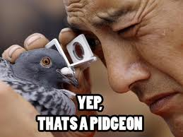
1
Open Problem / Opportunity Identification
Open Identification of Problems/Opportunities
Open identification of problems/opportunities is the process of searching and identifying one or several problems/opportunities to tackle. It is the start for problem solver who have no preference already, so the problem field and approach to identification are completely open.

Slide 7
1
Open Problem / Opportunity Identification
Open Identification of Problems/Opportunities -
Imperative and Voluntary Problems
There are two broad types of problems people identify and try to solve, regardless of success or failure:
Imperative or Forced Problems - these are problems people can hardly avoid identifying and facing for reasons of pain, threat, subservience, commitment to an ideal, etc.
Voluntary Problems – these are problems people freely identify and choose to tackle because of direct or indirect, positive or negative, concerns for their own well being or that of others. The identification and pursuit of opportunities is a typical case of voluntary problem.
The borders between the two broad categories are not absolute or objective. It is a matter of perception. Sometimes what should have been an imperative problem is identified late (only after the damage is done) or treated as a “voluntary” problem and vice-versa.
For learning purposes, the social innovation problems aimed at improving the community are “voluntary problems.” Any problem identified and selected is as valid as any other.

Slide 8
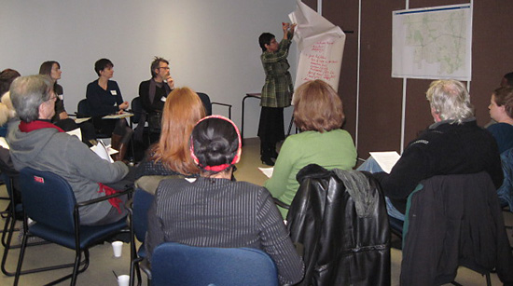
1
Open Problem / Opportunity Identification
Open Identification of Problems/Opportunities
Methods to Identify Problems (One or Many)
Problem solvers can use several research methods to identify community problems they would wish to tackle. The methods can be used in combination.
Problem Solvers’ Discussion Group
Quantitative Survey Research
Methods to Identify Community Problems
Expert
Consultation
Desk Research
Grassroots
Consultation
Serendipitous/Inspiration Research

Slide 9
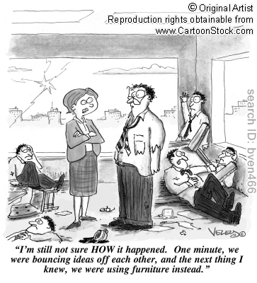
1
Open Problem / Opportunity Identification
Methods to Identify Problems (One or Many)
Problem Solvers’ Discussion Groups (1)
Problem Solvers’ Discussion Group are used to identify problems based on problem solvers’ own knowledge, competences, talents, intuition, experience and motivation, not necessarily all of them together. For instance, the group may have plenty of motivation to tackle certain problems but little knowledge and experience. This may be enough to consider the problems as possible targets to pursue.
Advantage
Simple and quick since all ideas are produced internally by the group.
Limitation
Source of ideas may be limited in terms of knowledge, experience and so on.

Slide 10
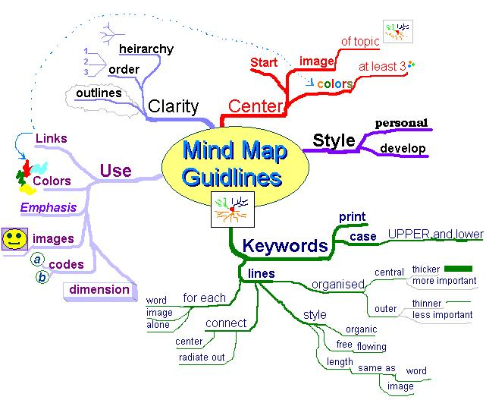
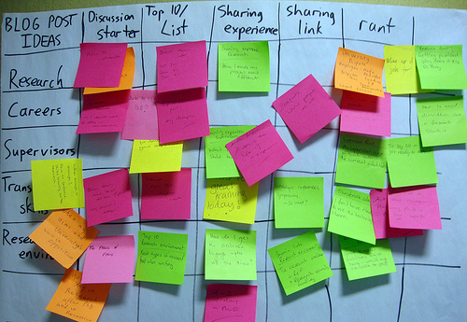
1
Open Problem / Opportunity Identification
Methods to Identify Problems (One or Many)
Problem Solvers’ Discussion Groups (2)
Organization and Instruments of Discussion Groups. The group organization must secure the free production, recording and grouping of ideas, potentially, leading to the generation of an ideas map. These activities demand roles that can be played by one or more people in the group. There are many instruments to support these activities from simple pen and paper to whiteboards, flipcharts, stickers, computers, low-cost interactive whiteboards, mind-mapping software, etc.

Slide 11
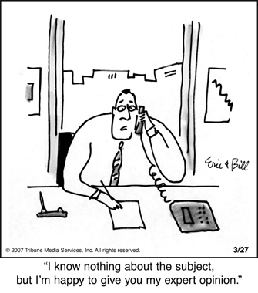
1
Open Problem / Opportunity Identification
Methods to Identify Problems (One or Many)
Consultation with Experts (1)
Expert Consultation is used when the problem solvers decide they need further information and knowledge to identify relevant problems in the community. The experts are people with strong knowledge, experience, and/or innovative approaches to the development of the particular community. If appropriate and possible, problem solvers may even attempt to create an Expert Advisory Panel.
Limitation
It requires proper time for the identification of relevant experts and the preparation, running and processing of interviews and analysis of the ideas generated
Advantage
It expands the knowledge resource and hence, problem identification potential, available to the problem solver group. It also creates a valuable network of people. Greater learning.

Slide 12
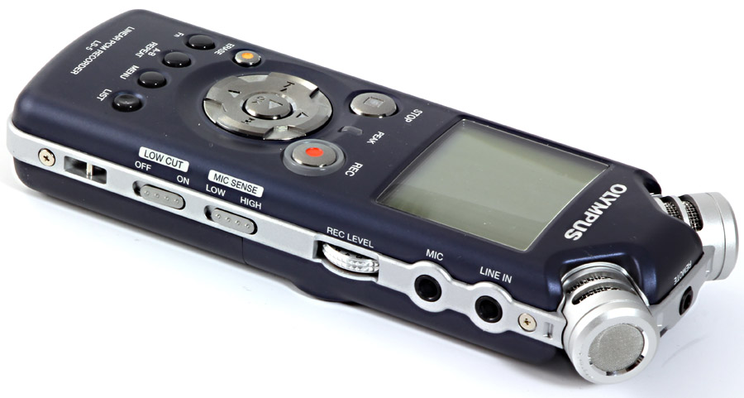
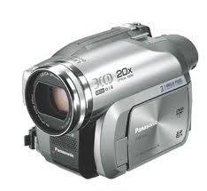
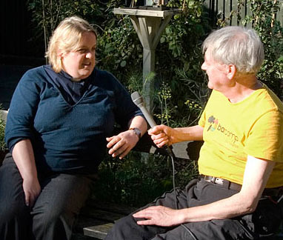
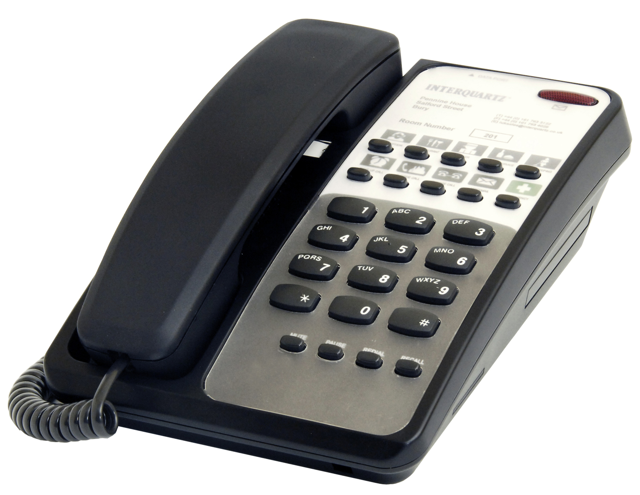
1
Open Problem / Opportunity Identification
Methods to Identify Problems (One or Many)
Consultation with Experts (2)
Organization and Instruments for Expert Consultation. The organization must secure the effective generation, recording and processing of the experts’ ideas, potentially, leading to the generation of an experts’ ideas map. These activities demand roles such as experts finders, communicators, interviewers, interview processors and analysers. There are many instruments to support these activities such as interview guides, paper notebooks, audio and video recorders, computers for email communication or video-conferencing (e.g., Skype), mind-mapping software, etc.
Interview
Guide

Slide 13
1
Open Problem / Opportunity Identification
Methods to Identify Problems (One or Many)
Grassroots Consultation (1)
Grassroots Consultation is used when the problem solvers decide they need further information and knowledge from the community itself to identify relevant problems in the community. It can be through several mechanisms such as (1) random walks and interviews; (2) focused groups with a selection of various actors from the community; and (3) attending grassroots consultations organised by relevant organizations.
Limitation
It requires proper time for the preparation, running and processing of interviews and analysis of the ideas generated. In the case of focused groups, it requires their preparation and guidance
Advantage
It expands the problem solvers’ knowledge resource and hence, problem identification potential, by talking directly to people in the community. It also creates a valuable contact with the community.

Slide 14
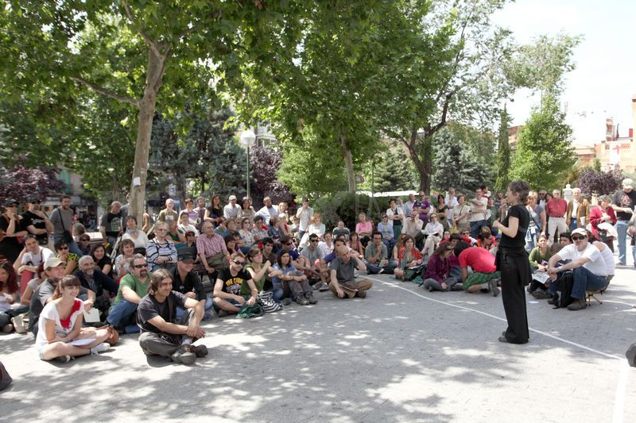
1
Open Problem / Opportunity Identification
Methods to Identify Problems (One or Many)
Grassroots Consultation (2)
Grassroots Consultation. The organization of the consultation must secure the effective generation, recording and processing of ideas from many people in the community, potentially, leading to the generation of a “community problems” map associated to different members of the community. These activities demand roles such as experts finders, communicators, interviewers, interview processors and analysers. There are many instruments to support these activities such as paper and computer notebooks, audio and video recorders, flipcharts, mind-mapping software, etc.

Slide 15
1
Open Problem / Opportunity Identification
Methods to Identify Problems (One or Many)
Quantitative Survey Research (1)
Quantitative Survey Research to gather information about the views of a wider part of the community. It can be targeted to one segment of the community (e.g., secondary school students), to several segments, or, to the entire population. It requires the use of appropriate sampling techniques and, normally, the questions are closed to enable quantitative processing and representation of results. The type of survey must be aligned with the time and resources available.
Limitation
It requires proper time and resources for the preparation, running and processing of quantitative survey, as well as population sampling and analysis of the ideas generated.
Advantage
It can provide information on the views and preferences of wide sectors of the population in a given geographical area.

Slide 16
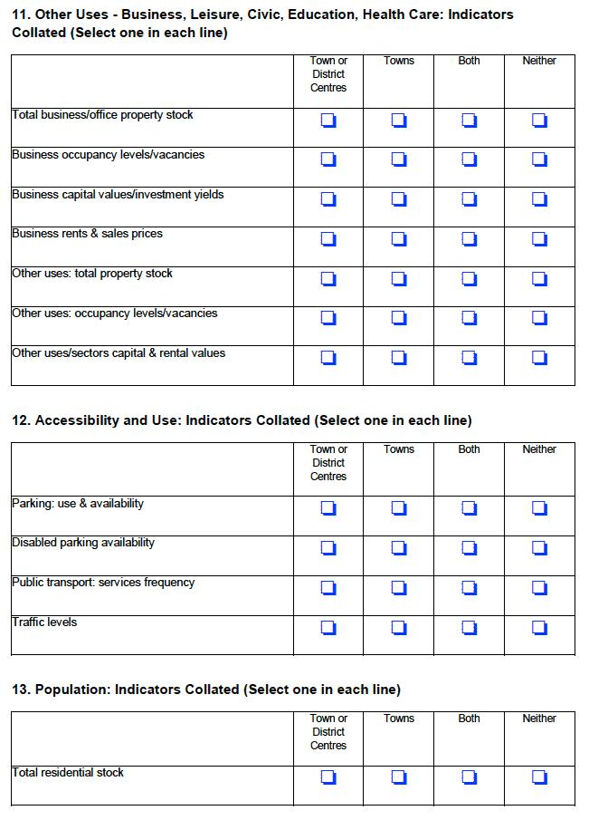
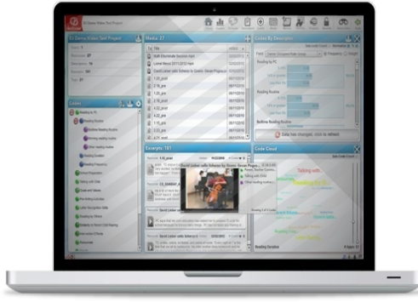
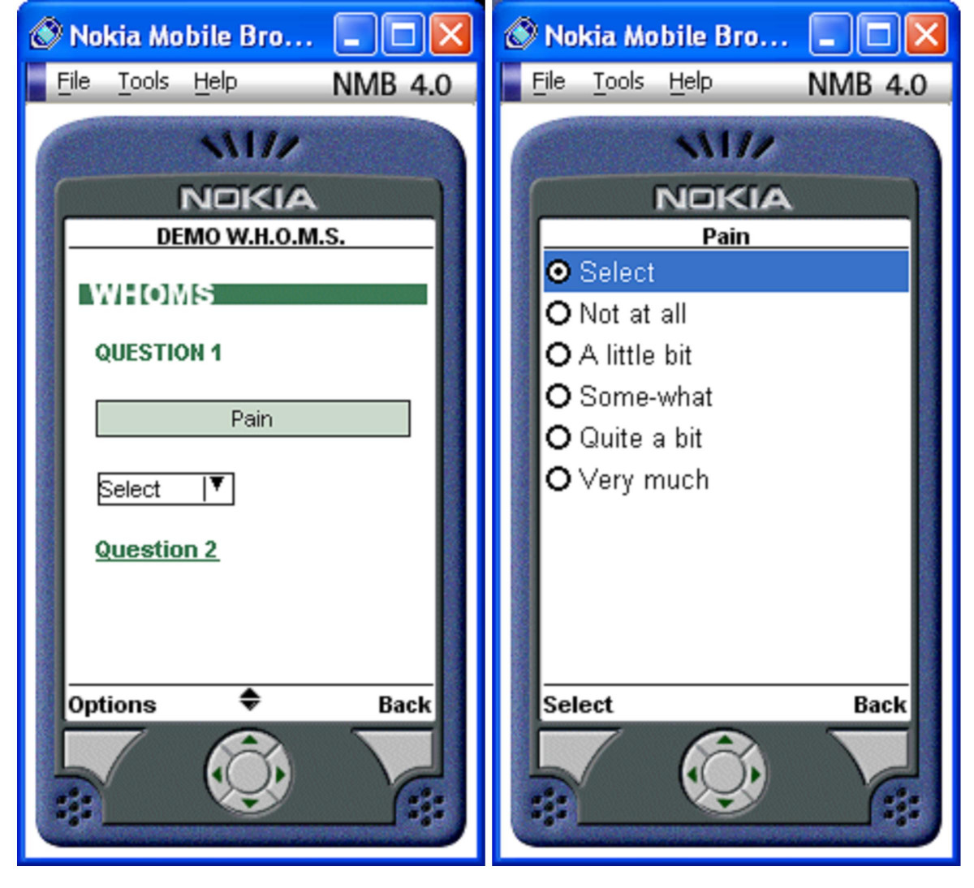
1
Open Problem / Opportunity Identification
Methods to Identify Problems (One or Many)
Quantitative Survey Research (2)
Quantitative Survey Research. The organization of the quantitative survey must define the overall survey approach, that is, whether, the survey will be in the street, by telephone, or online. In all cases, the preparation requires a survey questionnaire, a selection of sampling technique and sample population, and the data processing software for the graphic representation of the results. These activities demand roles such as survey experts, interviewers, statistical analysers, etc. There are many instruments to support these activities such as paper or electronic surveys, statistical analysis software, survey websites, etc.

Slide 17
1
Open Problem / Opportunity Identification
Methods to Identify Problems (One or Many)
Desk Research (1)
Desktop Research regarding the development of the community over the years. This include researching municipal deliberations at the level of district, as well as of the city. It also includes researching local sources of information (e.g., newspapers, newsletters, radio, internet, etc). Moreover, it includes reading about the history of the territory and community to see whether opportunities from the past lie hidden or simply ignored.
Limitation
Information is from secondary sources rather that from direct sources. It may be time consuming to research multiple sources where a lot of material might have accumulated.
Advantage
It can provide information on the state of problems long recognised by the community, including opportunities lying in the cultural, touristic and social assets existing in the community.

Slide 18
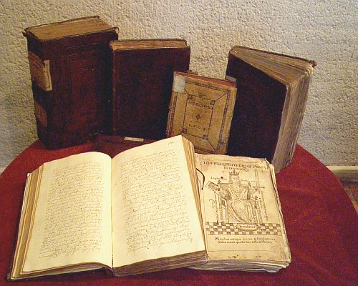
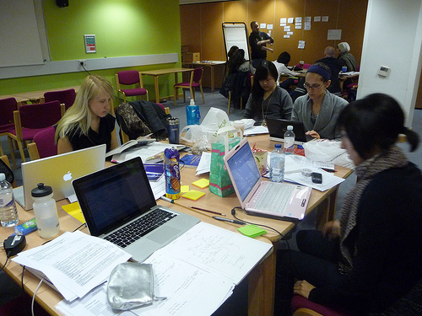
1
Open Problem / Opportunity Identification
Methods to Identify Problems (One or Many)
Desk Research (2)
Desk Research. The organization of the desk research must identify the physical and online sources to research. Relevant documents, news, books, databases can be found in libraries and archives with official and historical records. The advent of open data and open government is making available a lot of information to the public. These activities demand roles such as information officer, researcher, etc. There are many instruments to support these activities such as computers, paper or electronic databases, libraries and open government websites, productivity software, etc.

Slide 19
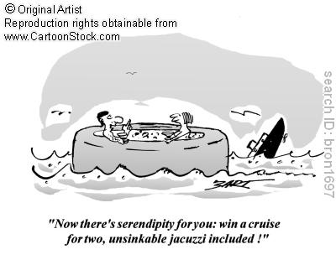
1
Open Problem / Opportunity Identification
Methods to Identify Problems (One or Many)
Serendipitous/Inspiration Research (1)
Serendipitous/Inspiration Research to discover by chance imaginative, innovative ideas that may be useful for the improvement of the community. In fact, serendipity is defined as the “knack of making fortunate discoveries unexpectedly, by accident or coincidence.” Inspiration research is a particular case of searching for ideas or projects on social innovations produced, developed and applied in other realities. There are many websites with information about social innovation projects around the world.
Limitation
There is no guarantee that insights suitable for the characteristics of the community and available resources will be found
Advantage
It can generate insights on innovative opportunities and ways of improving the community, by tapping on globally distributed information

Slide 20
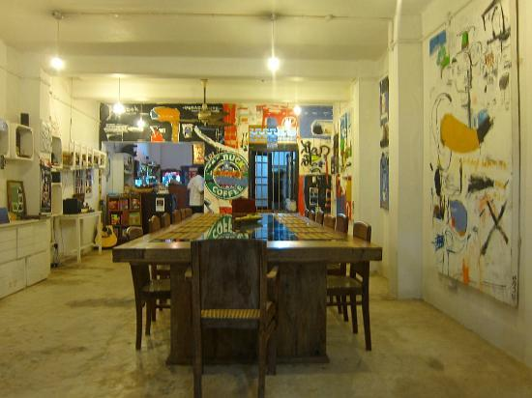
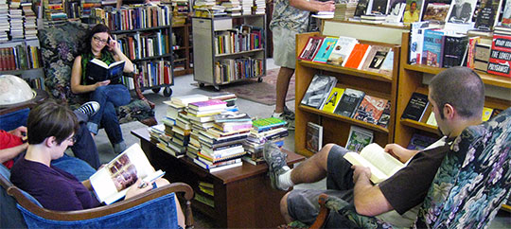
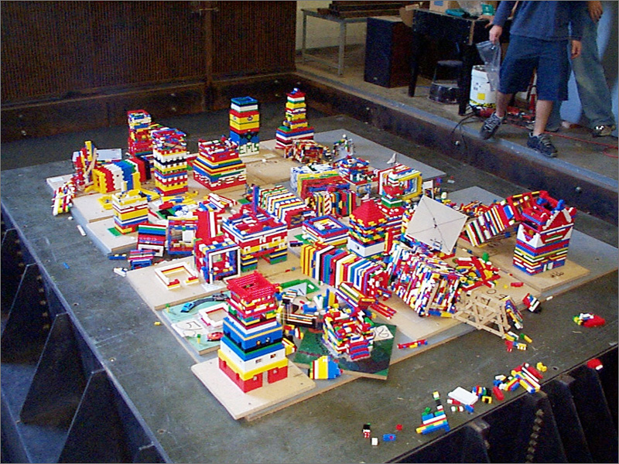
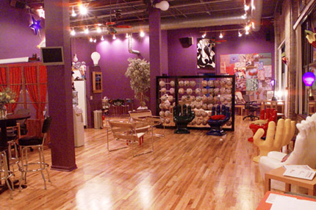
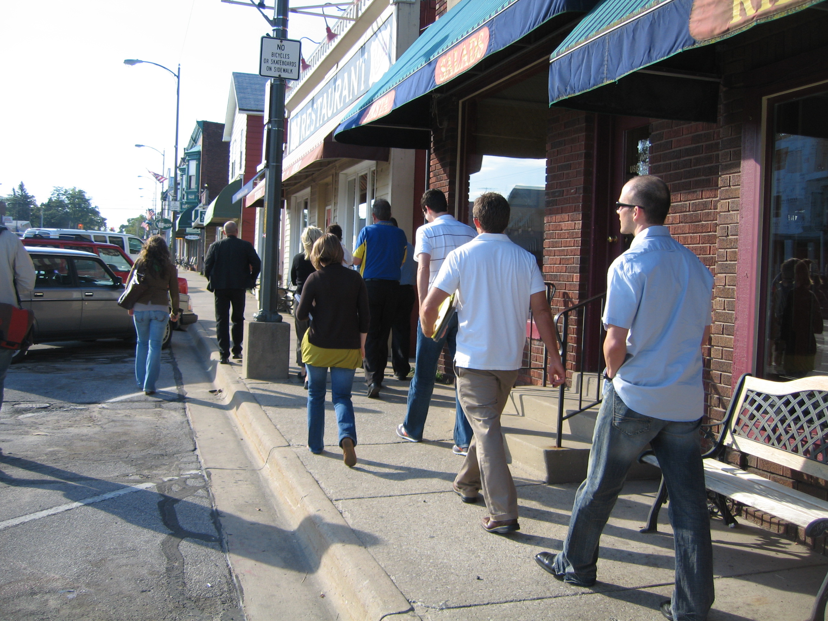
1
Open Problem / Opportunity Identification
Methods to Identify Problems (One or Many)
Serendipitous / Inspiration Research (2)
Serendipitous/Inspiration Research. The organization of the serendipitous/inspiration research must identify the physical and online sources of potential serendipitous ideas. These can be libraries, internet, creativity rooms, peaceful places, curiosity shops, community streets, … the world. The research activity demands a high degree of attention and alertness to spot ideas with good potential for adaptation or reframing into different community contexts. There are many instruments to support these activities such as computers, libraries, project websites, random number, word, image generators, productivity software, etc.

Slide 21
Problem/Opportunity Identification- Wisdom
Consult not your fears but your hopes and your dreams. Think not about your frustrations, but about your unfulfilled potential. Concern yourself not with what you tried and failed in, but with what it is still possible for you to do.
Pope John XXIII
There'll always be serendipity involved in discovery.
Jeff Bezos
Innovation is serendipity, so you don't know what people will make.
Tim Berners Lee
The power of a focus group lies in its ability to leverage multiple channels of communication and thought. When you buckle down and really explore the many facets of a possible innovation to the organization, you are more able to make well thought-out decisions.
Craig Cochran
You can use all the quantitative data you can get, but you still have to distrust it and use your own intelligence and judgment.
Alvin Toffler
There are as many opinions as there are experts.
Franklin D. Roosevelt
In terms of technological progress, the public is slower than focus group.
Toba Beta
We are all experts in our own little niches.
Alex Trebek

Slide 22
Problem/Opportunity Identification
- Poetry
Serendipity
Sometimes you never know, When or where she is going to show. She may get you by surprise. You never surely know, She may just be in disguise. If you haven't, look hard and around. If you doubt, she's probably already found. Believe that you will... You might be in for a thrill, that having to wait, Could have only been Fate.
David Joel Rodriguez
Experts
Experts who trust the way of life, Who love the learning, are precious. Experts can not live like us If they are separate. Learn the expertise that is real, And be diligent in the role of study.
Naveed Akram

Slide 23
Brief Questionnaire
How do you rate the usefulness of the following elements for your learning?
 | Very Low | Low | Moderate | High | Very High
Definition
Wisdom
Fun
Poetry
Assessment Instrument
What other elements would you like to see in the micro-module?

Slide 24
Acknowledgements
Developed by
Alfonso Molina
Sources
Various Quotation Websites
Various Poetry Websites
Various websites with images relating to the concept of Ideation
Copyright
This micro-module has been developed with the purpose of contributing to the personal and collective growth of all people, young and old. It is free to use. I have picked material freely from the web, without regard for copyright, in the hope that all authors will be happy to contribute to such a purpose. When this is not the case, please contact the author at A.Molina@ed.ac.uk

