Slide 1
Problem Solving Journey

Slide 2
Didactic Suggestions (1)
These are only suggestions, any group of learners is free to experiment with the use of the micro-module. The types, number and order of use of the elements in the micro-module are open to choice. Depending on the learning strategy adopted, elements can be also eliminated or added. For this purpose, the micro-modules can be copied and modified.
(I) Try to start by connecting with the current state of knowledge and experience of the individual in the group/s. This micro-module is fairly broad-level and constitutes a first step into the detailed understanding of the entire process of problem solving.
Organize students into group/s of 4 or 5.
Ask the participants in the group/s to explore their own broad understanding of the process of problem solving. Each participant should reflect on an experience of problem solving and try to identify major phases. All participants in the group discuss the results and try to produce a common understanding of the major phases.
All groups convene and each group presents the results to the others, explaining their reasons. Can the general discussion produce one agreed idea of the major phases in a process of problem solving?

Slide 3
Didactic Suggestions (2)
(II) Use the micro-module “Problem Solving Journey” to reinforce and deepen the broad understanding of the concept of Problem Solving Process
Introduce the micro-module “Problem Solving Journey” to the participants, explaining its multimedia, multi-dimensional, multi-role, multi-didactic intention.
Ask the participants in the group/s to explore the micro-module searching, focusing their attention and reflecting on those elements they find most effective in reinforcing and deepening their understanding of the concept of Problem Solving Process.
Each participant tells their groups about their first two choices of “most effective elements” and explain why they have selected them. The participants reflect collectively about their choices and their reasons. If some participants do not find the types of elements most appropriate to them, they can tell about those element and, even better, find them and contribute them to the micro-module.
The groups convene and share their results by selecting and presenting 2 choices of “most effective elements” per group, along with their conclusions as to why different people may have different preferences regarding elements and ways of learning.
Participants fill in the brief questionnaire about their preferences regarding the elements in the micro-module

Slide 4
Problem Solving Journey

Slide 5
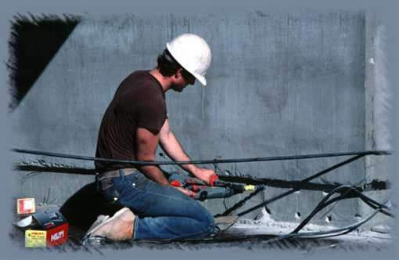
Problem Solving (Opportunity Taking)
In the broadest terms, the journey of problem solving (opportunity taking) is composed of two major activities: Ideation and Implementation. Ideation concerns the definition of problems and potential solutions. Implementation concerns the realization of the solutions. The two activities are deeply interrelated with no absolute borders between them. The relationship can also be highly dynamic depending on the nature of the problems at hand (see 5M “the Nature of Problems”).
Problem Solving
Ideation
Implementation

Slide 6
Problem Solving (Opportunity Taking)
The pair Ideation-Implementation can be decomposed into four activities; two for Ideation: (1) Problem Identification and Selection and (2) Solution Identification and Selection. Two for Implementation: (3) Prototyping (Proof of Concept) of the selected solution and (4) Diffusion (Scalability) of the prototyped solution through the target areas of society.
2
3
Solution Identification and Selection
Prototyping
(Proof of Concept)
Problem Solving
Ideation
Implementation
1
4
Problem Identification and Selection
Diffusion
(Scalability)

Slide 7
Problem Solving - Wisdom
Life is problems. Living is solving problems.
Raymond E. Feist
(GoodReads)
Creating something is all about problem-solving.
Philip Seymour Hoffman
(BrainyQuote)
All Life is Problem Solving
Karl Popper (title of book)
Too many problem-solving sessions become battlegrounds where decisions are made based on power rather than intelligence.
Margaret J. Wheatley
(BrainyQuote)
If I had an hour to solve a problem I'd spend 55 minutes thinking about the problem and 5 minutes thinking about solutions.
Albert Einstein
(GoodReads)
It is well known that "problem avoidance" is an important part of problem solving. Instead of solving the problem you go upstream and alter the system so that the problem does not occur in the first place.
Edward Bono
(Great-Quotes)
Walking is good for solving problems - it's like the feet are little psychiatrists.
Pepper Giardino
(FinestQuotes)

Slide 8
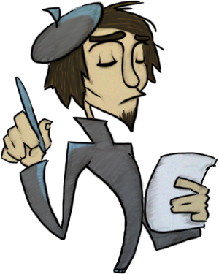
Problem Solving
When I have a problem And I don’t know How to solve it, I ask you for your input And you help me To resolve it. Talking with you Cheers me up And helps to make me see My problem’s not So difficult As it seemed to be. Sometimes I just get Overwhelmed and Can’t make a decision, But you speak to me So sensibly and I appreciate your vision. Your soothing voice And common sense, Invaluable to me; And your point of view’s Well taken, Even when I don’t agree.
Gail Grierson
Problem Solving
- Poetry

Slide 9
Brief Questionnaire
How do you rate the usefulness of the following elements for your learning?
 | Very Low | Low | Moderate | High | Very High
Definition
Wisdom
Fun
Poetry
Assessment Instrument
What other elements would you like to see in the micro-module?

Slide 10
Acknowledgements
Developed by
Alfonso Molina
Sources
Various Quotation Websites
Various Poetry Websites
Various websites with images relating to the concept of Ideation
Copyright
This micro-module has been developed with the purpose of contributing to the personal and collective growth of all people, young and old. It is free to use. I have picked material freely from the web, without regard for copyright, in the hope that all authors will be happy to contribute to such a purpose. When this is not the case, please contact the author at A.Molina@ed.ac.uk

